Slide 1
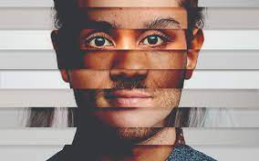
Friday 2nd May
Stereotypes

Slide 2
Look back at your mad scientist drawing from morning work.
Was it a stereotypical or non-stereotypical? How?
Why do you think people think scientists look a certain way?

Slide 3
Stereotypes
Definition
Stereotypes are a commonly held public belief about specific social groups or types of individuals. This can be done through the simplified representation of character, appearances and beliefs.

Slide 4
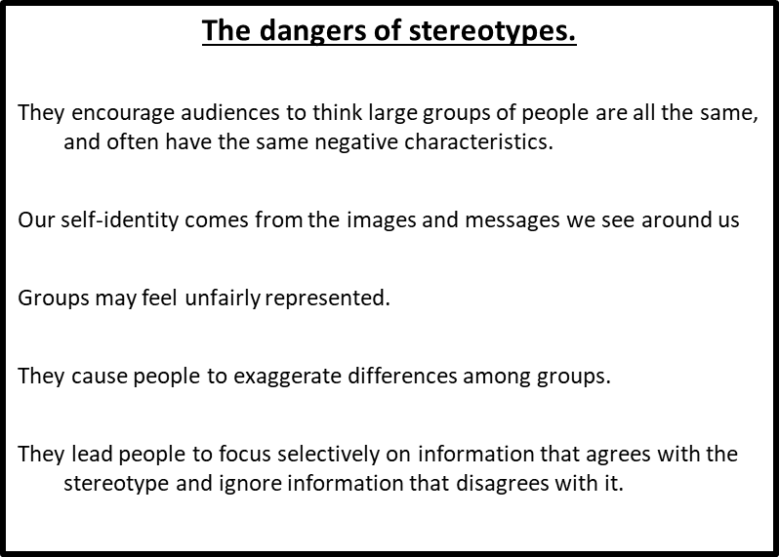

Slide 5
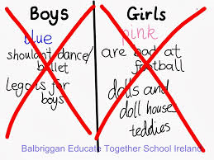
Gender stereotypes exercise
Look at the following ‘rules’ and sort them into what you think is expected more of teenage girls and what is expected more of teenage boys. Make sure you put each rule in either boys or girls – not both.
• Be sensible
• Don’t cry
• Be good at fixing things
• Be neat and organised
• Don’t be affectionate
• Be gentle
• Take risks and be daring
• Love sport
Notes:
Ask if pupils think it’s fair that there can be different rules for girls and boys, what happens if these rules are broken and which rules they think should be challenged.

Slide 6
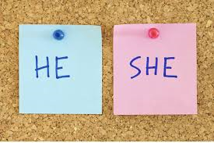
Gender stereotypes
Which ‘rules’ did you match to boys?
Which ‘rules’ did you match to girls?
How easy was it?
How do you feel being labelled in this way?
What could be the problem with being labelled in this way?
Notes:
class discussion where students feel comfortable to share their thoughts

Slide 7
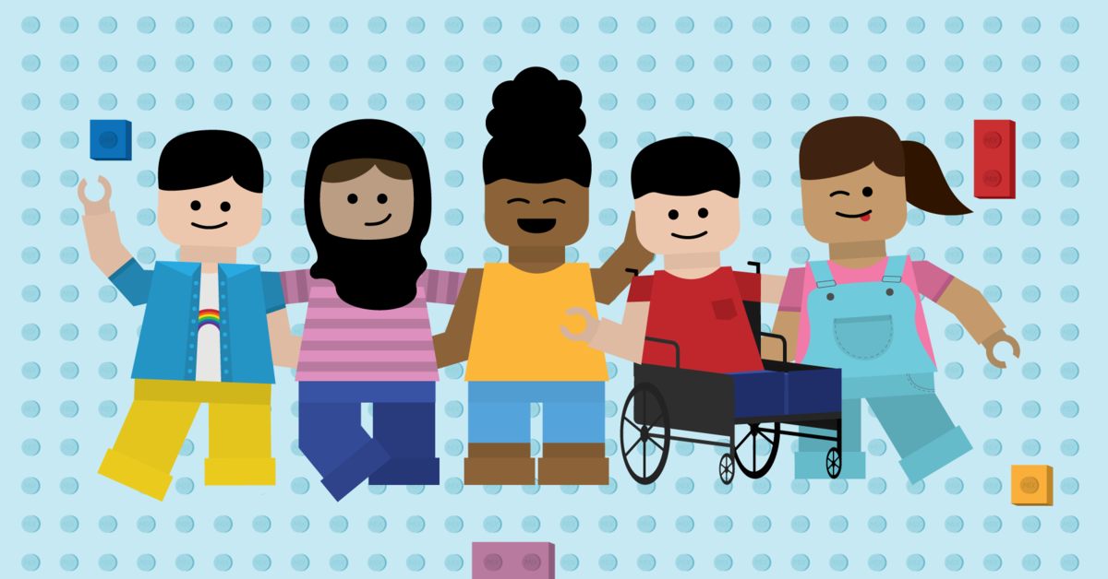
What are some examples of stereotypes?
How might someone finish these sentences?
All girls………………………………………………………………
All boys ……………………………………………………………..
All teenagers ………………………………………………………
All parents …………………………………………………………
All teachers …………………………………………………………
All older people …………………………………………………….

Slide 8
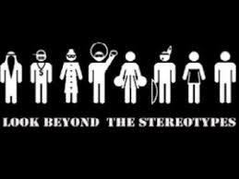
Stereotypes and prejudice
Stereotypes: thinking all people who belong to a certain group are the same and labelling them, for example all young people who wear hoodies are thugs.
Prejudice: judging someone without knowing them, on the basis of what they look like or what group they belong to, for example all black people are good dancers.
Task 1 –
Write down your own definition of stereotype.

Slide 9
Pregnancy and maternity
Pregnancy is the condition of being pregnant or expecting a baby. Maternity refers to the period after the birth, and is linked to maternity leave in the employment context.
Race
Refers to the protected characteristic of race. It refers to a group of people defined by their race, colour, and nationality (including citizenship) ethnic or national origins.
Religion and belief
Religion refers to any religion, including a lack of religion. Generally, a belief should affect your life choices or the way you live for it to be included in the definition.
Sex
A man or a woman.
Sexual orientation
Whether a person's sexual attraction is towards their own sex, the opposite sex or to both sexes.
Definition of the protected characteristics.
Age
A person belonging to a particular age (for example 32 year olds) or range of ages (for example 18 to 30 year olds).
Disability
A person has a disability if she or he has a physical or mental impairment which has a substantial and long-term adverse effect on that person's ability to carry out normal day-to-day activities.
Gender reassignment
The process of transitioning from one sex to another.
Marriage and civil partnership
Marriage is a union between a man and a woman or between a same-sex couple.
Same-sex couples can also have their relationships legally recognised as 'civil partnerships'. Civil partners must not be treated less favourably than married couples (except where permitted by the Equality Act).

Slide 10
The laws!
These are the various laws that have been put in place over the last 50ish years to make sure there is as little prejudice happening as possible.
In 2010 a new piece of legislation (law) came into play which covered all the previous laws and put them into one group.

Slide 11
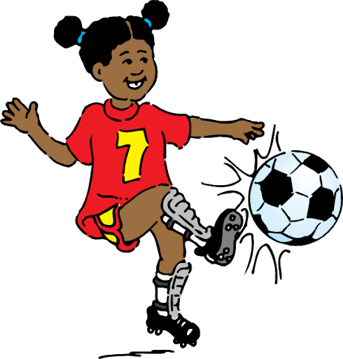
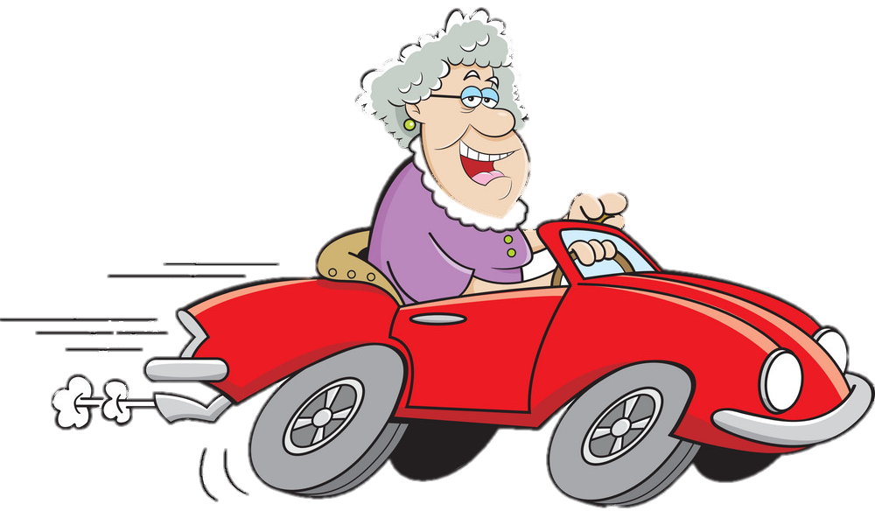
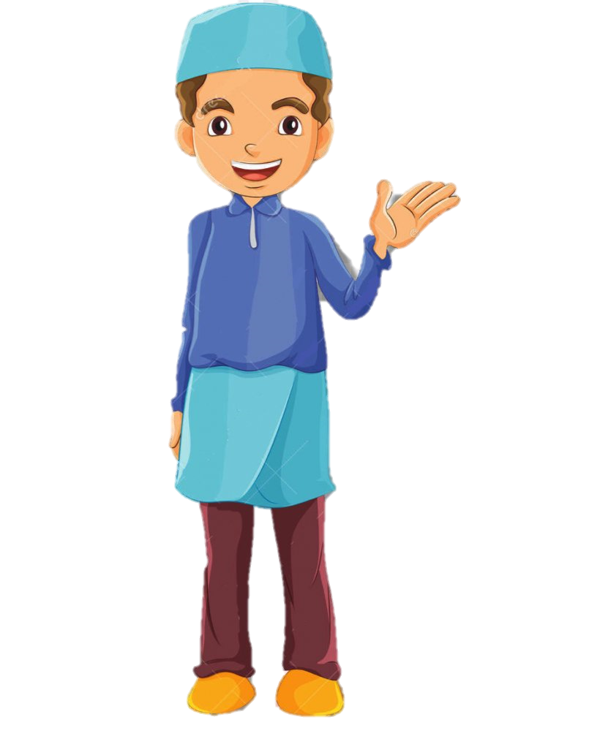
What would you do if you heard these? What would you say back?
‘She is really good at football but I don’t think the boys should have to cope with a girl on their team.
?
1.)
My Granny recently said to my Dad that she was thinking of getting a sports car. My Dad laughed and said: “You’re too old!”
?
2.)
‘I’d better not invite him to my party as he probably can’t eat the same food as us because of his religion.’
?
3.)

Slide 12
Task 2
Draw another scientist who is not ‘stereotypical’
Stick them in side by side.
This is the non-stereotypical scientist. They challenge stereotypes by….
This is a stereotypical scientist. Stereotypes can be harmful because…

Slide 13
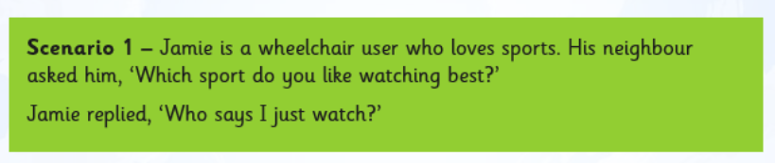
Disco Develop
Why do you think the neighbour asked Jamie what sports he liked to watch, instead of what sports do you like to play?
What stereotype does the neighbour hold about Jamie? Why do you think that is?
Sentence starters:
I think the neighbour assumed Jamie watched sport because……..
As Jamie has a visible disability I think the neighbour thought Jamie………………… I think its because the stereotype he holds of disabled people is ………..

