Slide 1


Cognition & Learning
Maintain focus and attention for short periods of time
Link ideas together using known knowledge and facts
Be receptive to key vocabulary around a topic or area of learning
Remember known words and phrases from simple rhymes and stories
The Ark at South Wilford
Communication & Interaction
Use visual cues to communicate with others
Use verbal language to communicate wants and needs
Use known images, words and phrases to interact with the environment and others
Use story, song and rhyme to consolidate learning
The purpose of the Ark is to provide children with additional needs with targeted support and intervention to enable them to access the curriculum and make progress academically, emotionally and socially.
Rationale
Sensory & Processing
Understand how the body and oneself can have cause and effect interchangeably within the environment
Process and follow simple instructions given
Become receptive to sensory stimuli and inputs that impact on emotional wellbeing
Social & Emotional
Build and maintain relationships with peers and staff
Share with others cooperatively
Acknowledge zones of regulation and be receptive to strategies to move between zones
Understand how to work alongside and cooperatively with others on a given task
Alongside programmes including music interaction, chatterbox, story sack and construction, children are encouraged to access the sensory equipment in the room to help them to meet their sensory needs whether proprioceptive, auditory, visual or interoceptive.

Slide 2
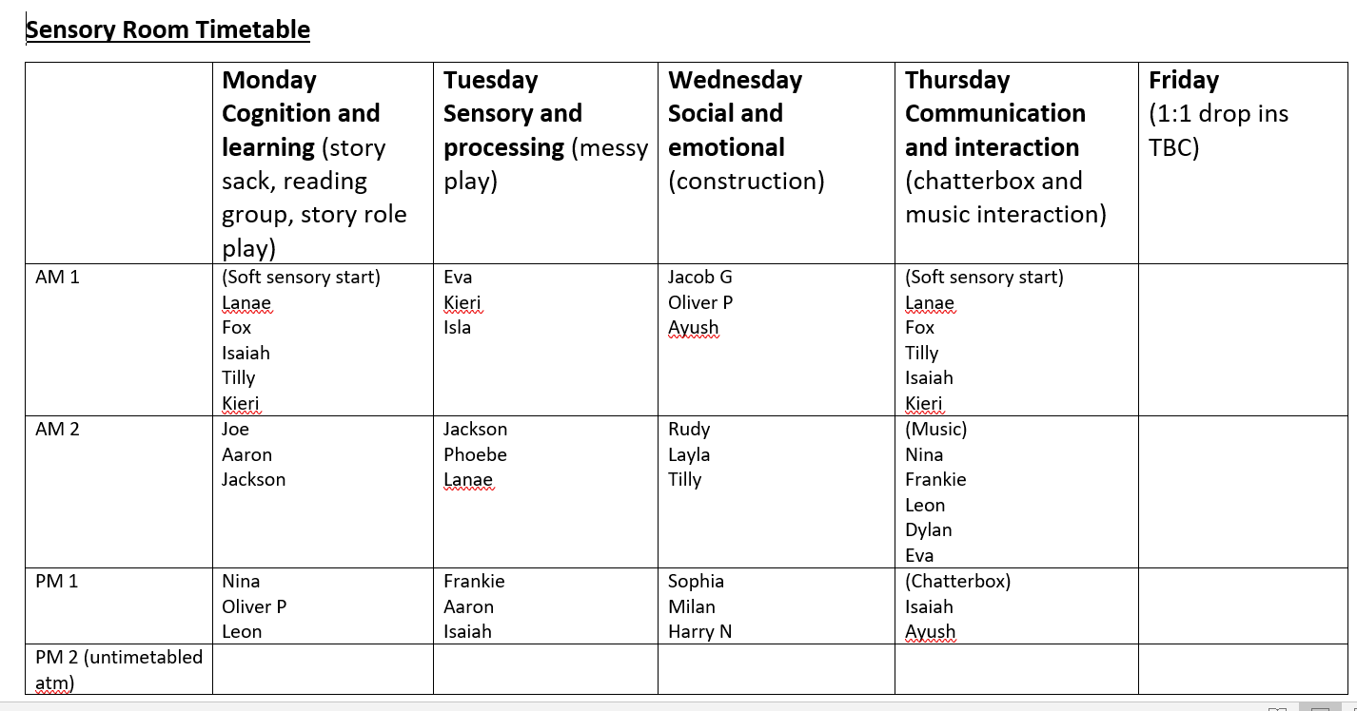

Focus of provision
AET targets
Whilst accessing the ark, adults working with the children will observe and take note of progress made against AET targets. These are shared with class teachers at termly SEN reviews.
Sensory Audit
Children have a sensory audit completed termly which enables staff working with them in the Ark to target the senses they are seeking or avoiding and support them accordingly.
Adult support
Children who do not access individual adult support in the classroom can benefit from more individualised input in the ark.
Soft start
Some of our children find it difficult to leave their parents and carers in the morning. A softer start to the day enables them to regulate and start their morning lessons more regulated and receptive to demands given by their teachers.
B squared
Children working on B squared for their academic learning can build on and consolidate some of these skills in the ark with adult guidance and support.

Slide 3
How are children selected?
During pupil progress meetings, children with additional needs are prioritised and barriers to learning are explored with senior leaders. Support and intervention that can support them and meet their needs are then suggested and the SENCO and HLTA for SEN work together to target that child. This is reviewed termly. Selection is also a focus during SEND review meetings with teaching staff, parents and the SENCO. The following criteria are an example of some of the reasons children access the ark:
Special interests
Individual talents
Sensory needs
Communication difficulties
Strong likes and dislikes
Difficulties coming in to school

Slide 4
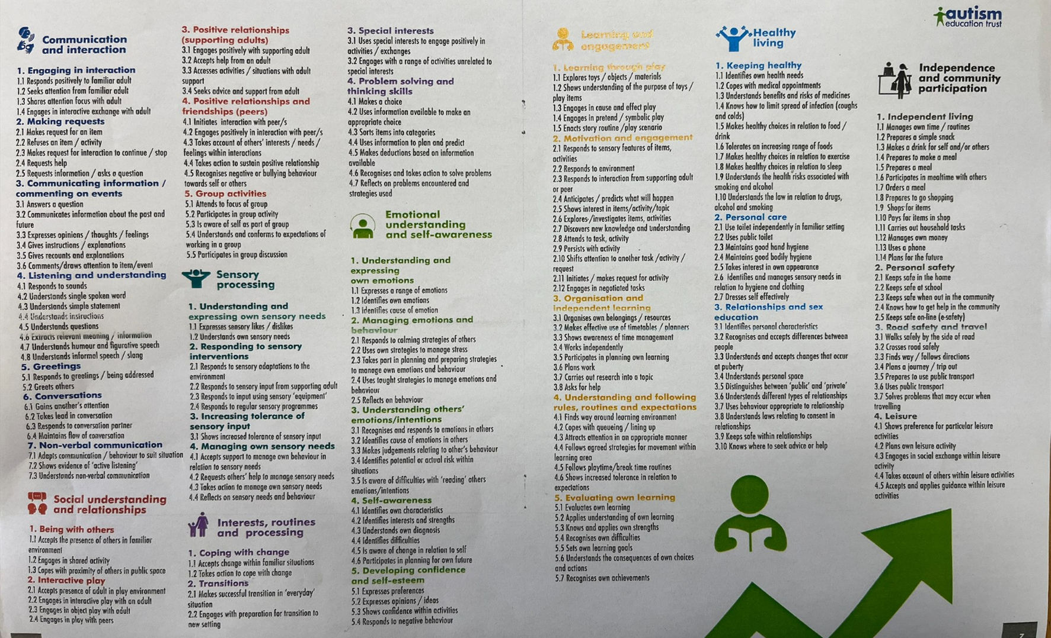
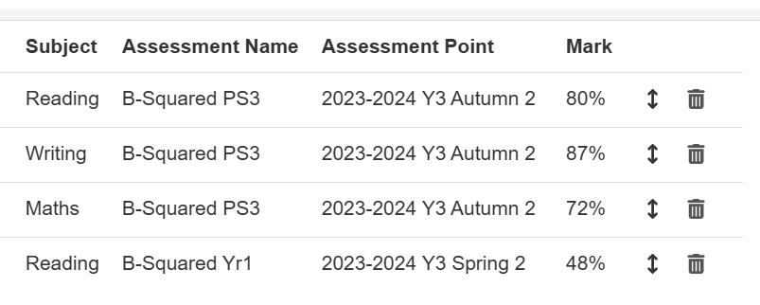
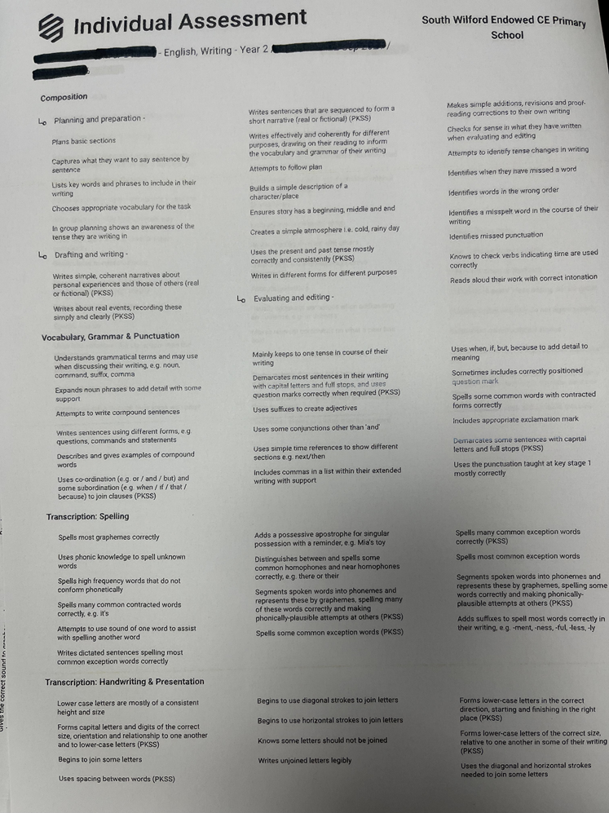
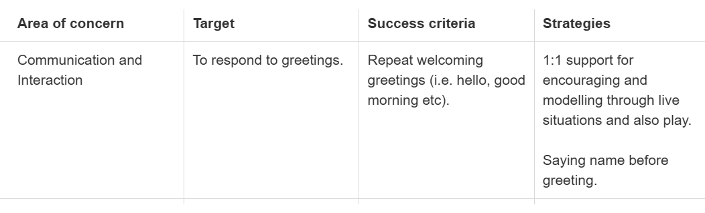
Assessment and tracking of progress
Progress against B squared and AET targets are updated termly and inputted on Insight tracking system. These then form a part of the child’s learning plan which is used by the SENCO and HLTA for SEN to inform foci and targets each term for children accessing the ark.

