Slide 1


Cognition & Learning
Maintain focus and attention for short periods of time
Link ideas together using known knowledge and facts
Be receptive to key vocabulary around a topic or area of learning
Remember known words and phrases from simple rhymes and stories
Forest school for SEN
Communication & Interaction
Use visual cues to communicate with others
Use verbal language to communicate wants and needs
Use known images, words and phrases to interact with the environment and others
Use story, song and rhyme to consolidate learning
The purpose of time in forest school for children with additional needs is to enable them to regulate throughout the day and have brain breaks between learning tasks with adult support.
Rationale
Sensory & Processing
Understand how the body and oneself can have cause and effect interchangeably within the environment
Process and follow simple instructions given
Become receptive to sensory stimuli and inputs that impact on emotional wellbeing
Social & Emotional
Build and maintain relationships with peers and staff
Share with others cooperatively
Acknowledge zones of regulation and be receptive to strategies to move between zones
Understand how to work alongside and cooperatively with others on a given task
Alongside sensory room intervention, children are encouraged to use this time outdoors with peers to build and maintain relationships with peers and communicate effectively with others whilst benefitting from being amongst nature.

Slide 2
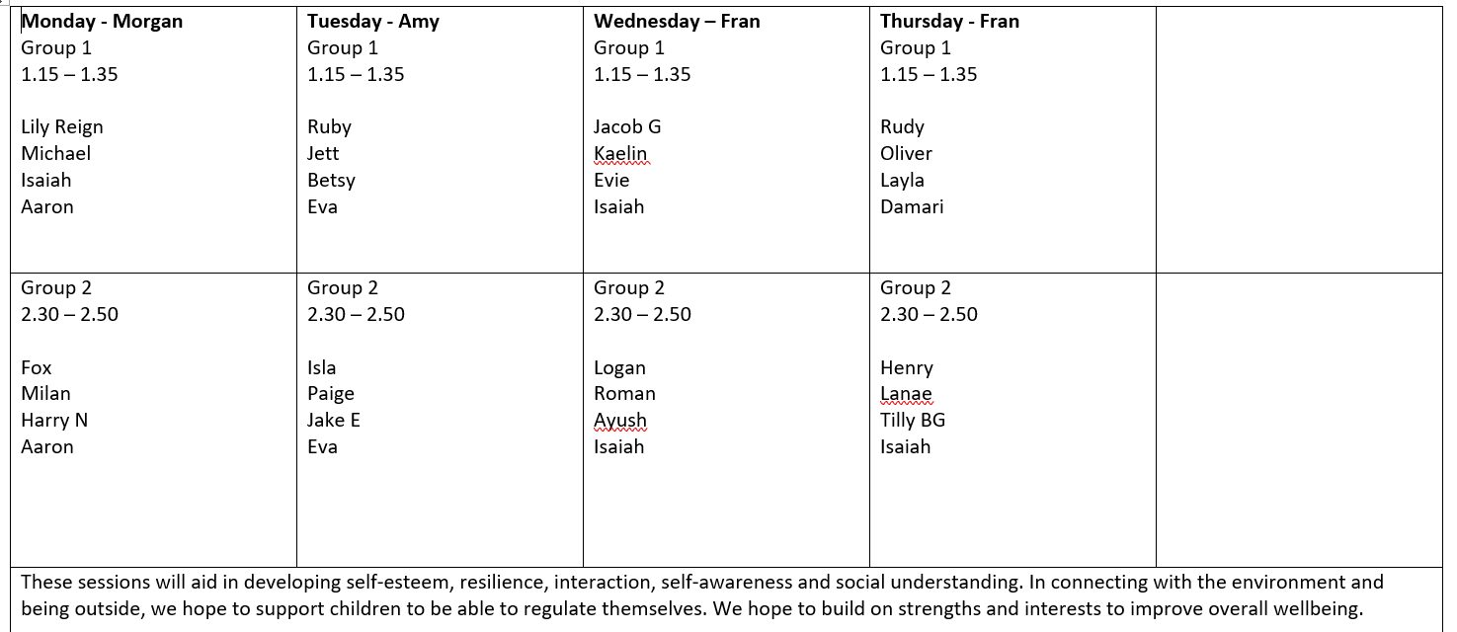

Focus of provision
AET targets
Whilst accessing forest schools, children will be working on team skills including building and developing understanding of receptive and expressive language as well as creating bonds and friendships with one another.
Sensory
Children have a sensory audit completed termly which enables staff working with them in Forest School to know which senses they seek and avoid and informs them of how to support individuals with these needs.
Adult support
Adults working in Forest School with children model effective communication skills to the children in small groups. They supervise team work and structured play.
Social and emotional development
Some of our children benefit from being able to work in a small team with adult support. This helps them to develop their tolerance of others and develops their ability to communicate with others in an appropriate way. This effective communication is modelled to them.
Brain breaks from lessons
Children benefit from going to Forest School as this allows them to have outdoor time to break up their day structure. They can use this time to transition from one lesson to another.

Slide 3
How are children selected?
During pupil progress meetings, children with additional needs are prioritised and barriers to learning are explored with senior leaders. Support and intervention that can support them and meet their needs are then suggested and the SENCO and HLTA for SEN work together to target that child. This is reviewed termly. Selection is also a focus during SEND review meetings with teaching staff, parents and the SENCO. Some of the following foci are used to plan and structure sessions half termly…
Den building
Treasure hunting
Hide and Seek
Branch balance and tree climb
Bug hunting/hotel building
Art work made from nature

