Slide 1


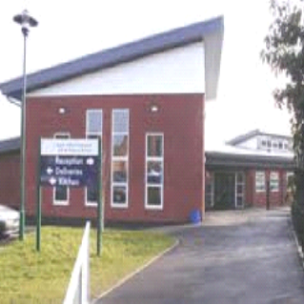
South Wilford Endowed CE
Primary School
New Starters’ Parents Information Session
Reception

Slide 2
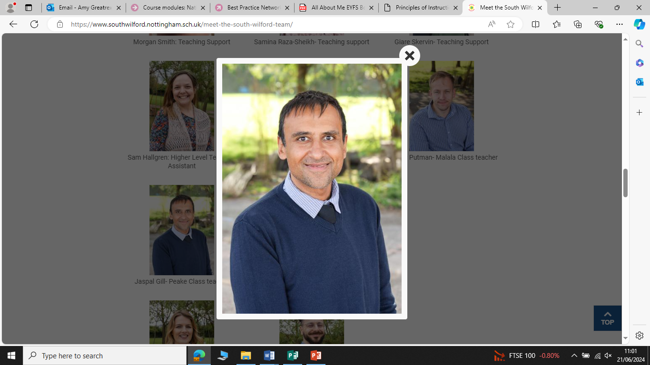
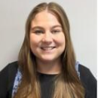
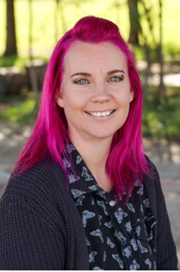
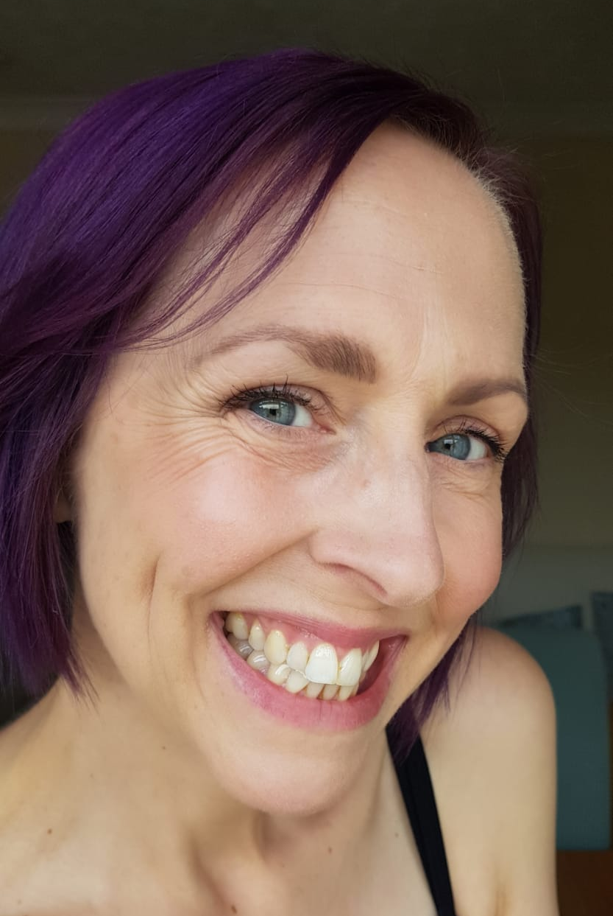
Meet the Team!
Headteacher Office Manager EYFS Phase Lead
Natalie Aldridge Heather Stannard Paige Rimell
Teachers: Jaspal Gill Paige Rimell
Teaching Assistants: Zoe Frankish Emma Williams

Slide 3
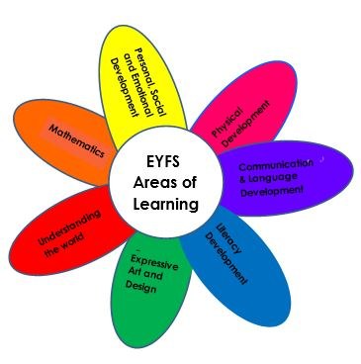
Early Years Curriculum
Seven Areas of Learning
Prime
Personal, Social and Emotional Development
Communication and Language
Physical Development
Specific
Literacy
Maths
Understanding the World
Expressive Arts and Design

Slide 4

Daily Routines
8:45 am: Classroom doors open
9:00 am: Registration
9:10 am: Phonics
9:35 am: Rhyme Time and Fruit/Milk
9:50 am: Challenge Time (child-initiated play) and adult-guided activities
11:15 am: Maths
11:45 am: Lunch time
1 pm: Registration
1:05 pm: Literacy/Topic
1:30 pm: Challenge Time (child-initiated play) and adult-guided activities
2:30pm: Collective Worship and Assembly Time
3.00 pm: Story time
3:15 pm: Home time

Slide 5

School Rule
At our school, we only have one rule: “Be At Our Best”,
which we apply to everything we do.
In EYFS, we also find it useful to follow these six guidelines:
We are gentle
We are kind and helpful
We listen
We are honest
We try our best
We look after everything

Slide 6
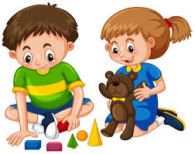
Learning through Play
Young children learn best through purposeful play and exploration.
At school the children learn through a mixture of:
Whole class teaching sessions
Small group adult-led focused activities
Child-initiated activities
Interactions during their play with peers and teaching staff
Weekly ‘Learning Challenges’ which they complete independently
Children are observed and assessed informally by all adults in the unit every day to gain a balance of adult-initiated and child-initiated evidence to help us monitor their progress and plan for their next steps and interests.

Slide 7
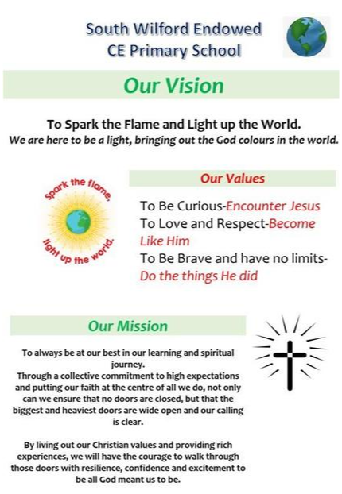
Our School Values

Slide 8
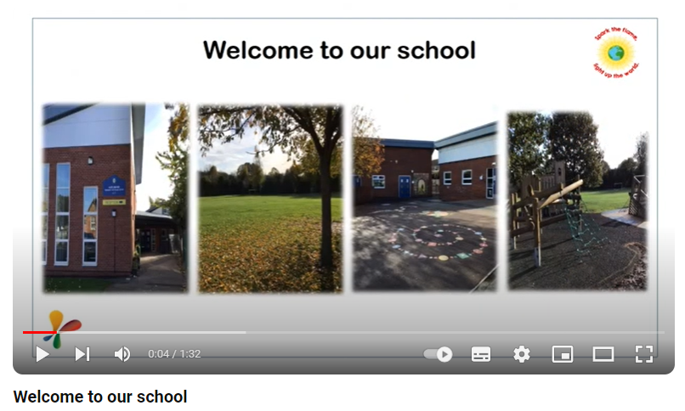
Our School Values
Welcome to our school - YouTube

Slide 9
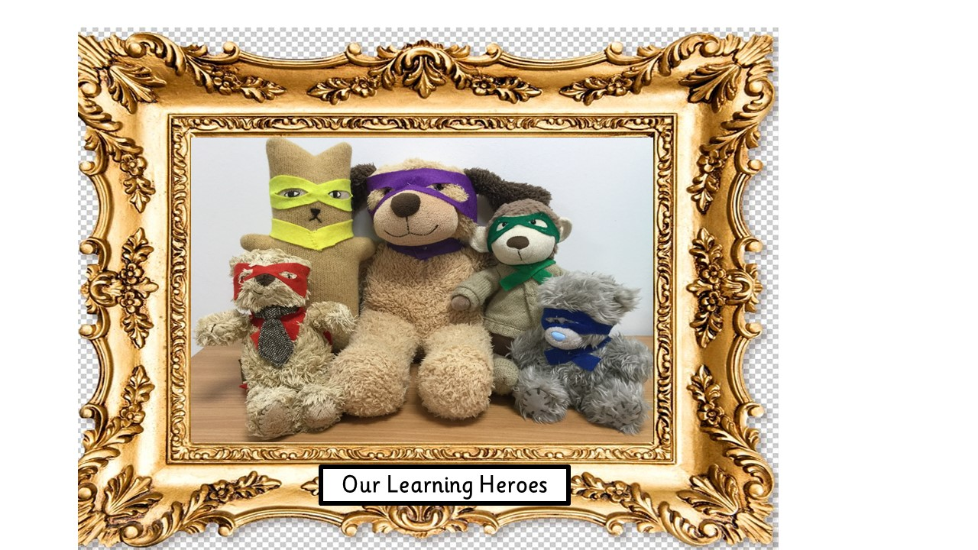
Our Learning Heroes
Have a Go Hero
Link and Learn Legend
Professor Perseverance
Agent Concentrate
Captain Curiosity

Slide 10

Literacy
Literacy in Foundation Stage is developed through:
Phonics
Reading
Writing
Role play
Rhyme Time
Reading for Pleasure!

Slide 11

Mathematics
Maths in Foundation Stage is developed through:
Stories, Songs and rhymes
Maths Lessons
Games
Maths Challenges
Daily routines

Slide 12
Our EYFS unit
Our two classrooms are split up into zones that cover all areas of learning. Children have access to all of these over the course of the day, inside and outside. Sometimes we work in family groups, sometimes we free-flow all together.
Lessons happen in the two separate carpet spaces with the dividing doors closed.
Children select and use resources independently and then move on to new ones, with or without adult intervention.
Our policy for ensuring that resources are cared for:
Choose it Use it Put it away

Slide 13
Classroom Areas
Funky Fingers Playdough Sand
Writing Phonics Book Corner
Maths Investigation Technology
Small World Construction Loose Parts
Role Play Creative Outside
Notes:
Creative Area: art, craft, models, painting, cutting, joining, gluing, collaging.
Role play: acting, dressing up, props story telling, imaginination, social skills, vocabulary.
Funky Fingers: finger muscle tone, scissor skills, twisting, threading, pincer grip.
ICT: iPads, computer, CD player, cameras, Beebots, microphones.
Book Corner: books, puppet theatre, small world for story retelling.
Writing Area: pens, crayons, pencils, felt-tips, paper, envelopes, notebooks, clipboards, whiteboards.
Maths Area: shapes, money, numerals, counting objects, dice, measuring resources, timers.
Investigation Station: mirrors, magnifying glasses, natural objects, torches, magnets.
Construction Area: Lego, Duplo, bricks, train track, wooden pieces, marble run, Tap-a-shape.
Playdough and sand area: rolling pins, cutters, tools, cake cases/trays, containers, moulds.
Small World: imagination, story telling, developing language, retelling stories, dolls, trees, cars.
Outside Area: climbing, riding, balls, tunnels, water wall, stage, instruments, large construction.

Slide 14



Bits and Bobs…
Label all belongings - coats, jumpers, shoes, hats, water bottles etc.
Book bags (no school bags please), and keep the water bottle out of the bag. You could use a carabiner clip or Bottle Buddi bag to attach it.
Clothing for the weather (coats all year, sun hats, sun cream applied).
Please email the office to let us know if there is a change to the person who will be collecting your child from school.
Water in bottles (not juice), milk and fruit provided in school.
Parking: please try to walk, scoot, or get the tram/bus to school as Wilford gets very congested and there is limited parking.
Children are allowed to bring in books from home to share at story time.

Slide 15
Bits and Bobs…
1. Dinners are ordered via an online system and parents will receive instructions, account details and authorisation codes over the next week or so.
2.Communication is via email and will go to the primary parent. For both parents to receive all information they will need to download school gateway – they should contact the office if they want to do this and we can give them further info.
3. Children who turn 5 in the autumn term are not eligible for free milk. If they would like their child to have a carton of milk each day then they will need to place an order via schoolmilkuk.co.uk. Milk info is on the website.
4. General reminder about ensuring birth certificate and proof of address have been seen at the office.

Slide 16
Communication
Newsletters
We send home half-termly newsletters with key information specific to our EYFS topics and news. There will also be whole school newsletters.
Emails, texts and telephones
We communicate electronically as much as possible so it is essential that we are aware of any changes to mobile telephone numbers and email addresses.
School website
This has information about term dates, school meals, learning, and more. Copies of all letters sent home will also be found here.
If you need to talk to someone …
Contact the school office via telephone, email or in person. Teachers are usually available at the end of the day for quick chats; for longer conversations, please make an appointment to meet with us at a mutually convenient time.
Reports and Consultations
We have Parents Evenings twice a year, and send home reports at the end of the year.

Slide 17

Medical
If your child has an inhaler, an epi-pen or requires other medication, please discuss this with us. We will ensure it is stored safely and securely.
We can only give prescribed medicine, and if your child needs this during the day, please go to the school office to fill a form in.
If your child is ill, please contact the office first thing in the morning by telephone, text or email.
Any sickness or diarrhoea, must be followed by 48 hours absence.
School nurses no longer carries out sight and hearing tests in school. Therefore, please go to the local opticians for a free eye test for your child, and, if you have concerns about their hearing, ask your GP for a referral to the Children’s Hearing Assessment Centre at The Ropewalk in Nottingham.

Slide 18
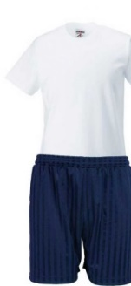
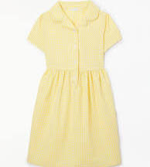
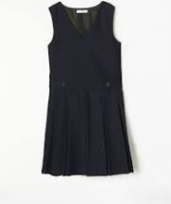
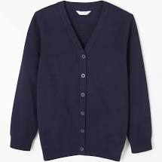




School Uniform
All children come to school wearing uniform. Our school colours are navy blue and yellow. Children are not to wear jewellery, including earrings.
The PE kit consists of white t-shirt and navy blue shorts. Children need to have long hair tied up. On our PE day, children come to school in their kit and velcro trainers and wear it all day. They do not need a PE bag or plimsolls.
Uniform is available from Kit Out Clothing: https://kitoutclothing.co.uk/
Pupils need to wear school shoes, except on PE day when they wear trainers.
Forest School is every week on a Wednesday afternoon. Your child will need a pair of wellies and waterproof clothing. This is kept at school and sent home every half term.
Please ensure ALL items of clothing (including coats and PE kit) are clearly labelled with your child’s name.

Slide 19
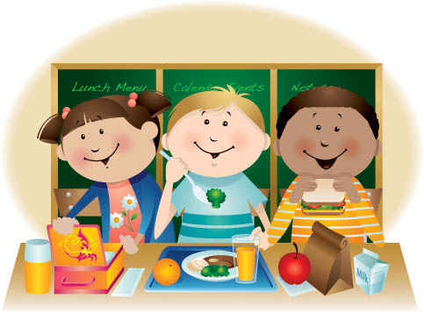
School Meals
School dinners are FREE for children aged 4-7!
All food is cooked on site and we design our own menu in school to ensure that it is well-balanced, as well as being appealing to the children.
There are three meals to choose from each day, which always includes a vegetarian option. You select your child’s meal online in advance to ensure that they get the meal that they want, and to minimise waste. This is done through Evolve, and if you don’t select a meal, they will get the default (jacket potato).
Children come into the hall, collect their meal from the serving hatch, with some support, and then sit to eat it with their class at a big table.
If you child has special dietary requirements for medical or religious reasons, then please let us know.

Slide 20
Free School Meals
Further up the school, your child may be entitled to free school meals if you receive any of the following:
Income Support
Income-based Jobseeker’s Allowance
Income-related Employment and Support Allowance
Support under Part VI of the Immigration and Asylum Act 1999
The guaranteed element of Pension Credit
Child Tax Credit (provided you’re not also entitled to Working Tax Credit and have an annual gross income of no more than £16,190)
Working Tax Credit run-on - paid for 4 weeks after you stop qualifying for Working Tax Credit
Universal Credit
The school can get extra funding based on the number of children eligible to Free School Meals.

Slide 21
Before they start school, please help your child become independent in…
Getting themselves dressed and undressed.
Using a knife and fork.
Going to the toilet independently.
Holding a pencil correctly and using scissors.
Recognising and writing their own name.
Taking turns and sharing with other children.
Tidying up after themselves.

Slide 22
Once your child has started our school, please…
Hear them read at least three times a week and write in their reading record when you do so.
Practise forming letters correctly, in lower case, and referring to them using the letter sounds rather than letter names.
Practise counting groups of objects accurately, and linking numerals to corresponding amounts.
Talk to them about their learning in school, using the EYFS year group page on the school website and our half-termly EYFS newsletter as starting points.

Slide 23

Once your child has started our school, please…
“I carried a watermelon!!”

Slide 24
Thank you!
We look forward to welcoming your child to our transition sessions.
Please bring along proof of address and your child’s birth certificate for the office to photocopy.
If you have any questions about the information given in this presentation or about your child starting school, please ask us or send an email to the school office.

