Slide 1


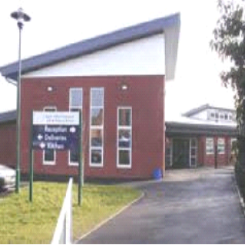
South Wilford Endowed CE
Primary School
New Starters’ Parents Information Session
Nursery

Slide 2
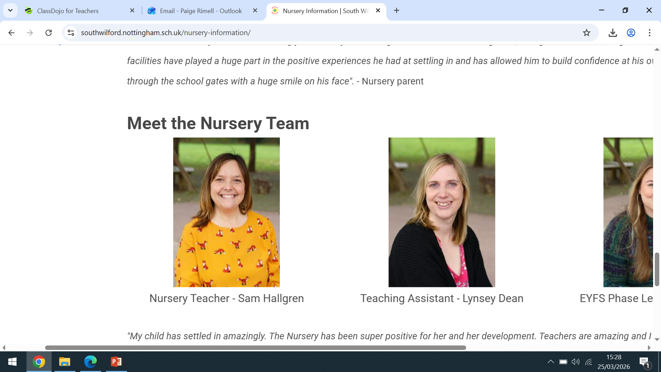
Meet the Team!
Headteacher Office Manager EYFS Phase Lead
Natalie Aldridge Heather Stannard Paige Rimell
Nursery Class Teacher:
Nursery Teaching Assistant:

Slide 3
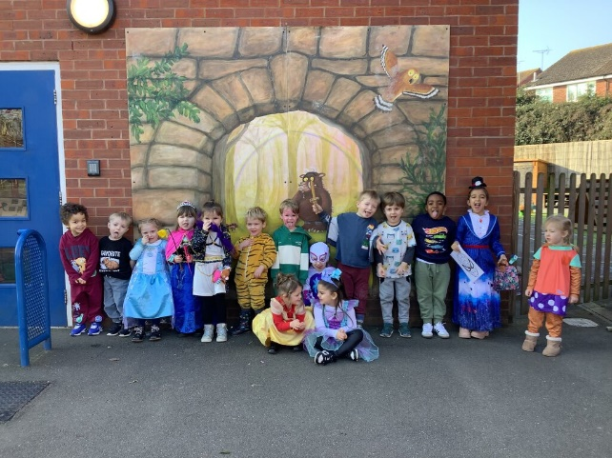

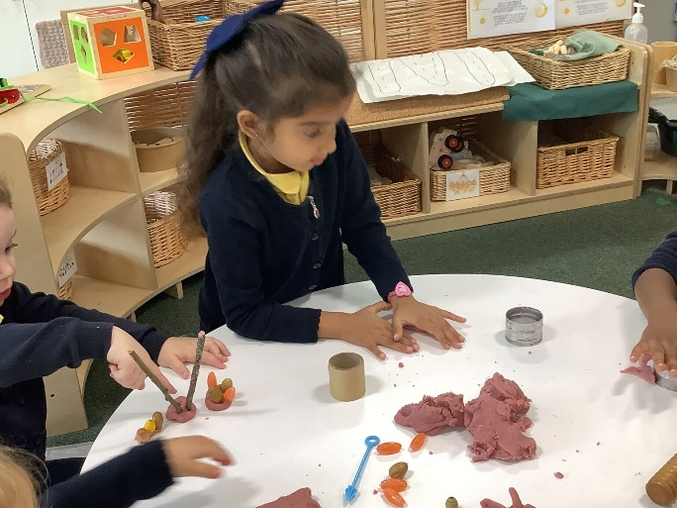
Our School Values

Slide 4
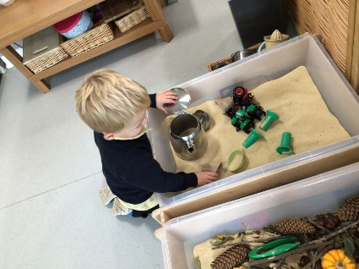
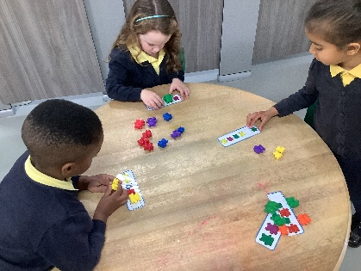
The School Day
Morning:
8.45: Meet & greet on arrival
9.00-10.00: Plan Do Review
10.00-10.15: Fruit and Milk
10.15-11.00: Small Group Time / Outside Time
11.00-11.30: Phonics
11.30-11.45: Story & Ready for Lunch
11.45: Lunch Time / End of session 1
Afternoon:
12.15: Meet & greet on arrival
12.30-1.30: Plan Do Review
1.30-2.30: Small Group Time / Outside Time
2.30-3.00: Welly Walk / Forest School / The Farm
3.00-3.15: Story & Ready for Home
3.15: Home Time / End of session 2

Slide 5
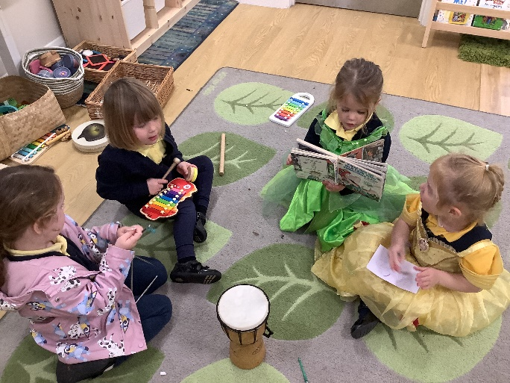
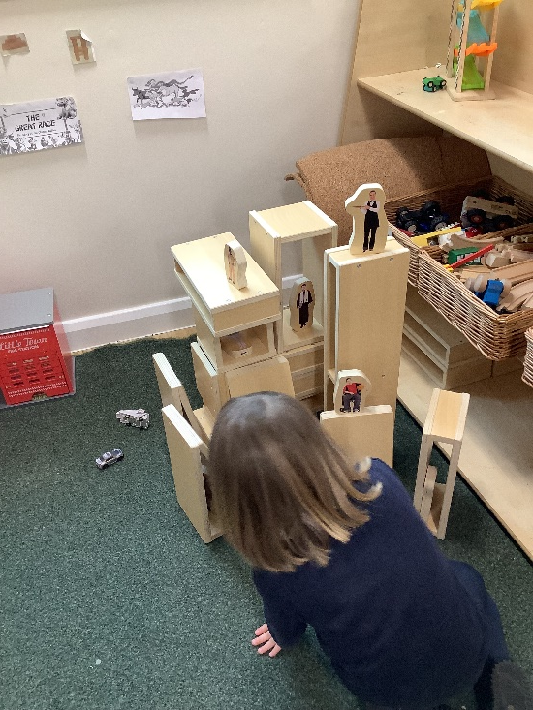
Plan Do Review
Children learn best from active learning experiences which they plan and carry out themselves (child-led).
In this way children learn that they are capable, able to make decisions and solve problems about activities which are personally meaningful to themselves.
PLAN - what they would like to do
DO - whatever play activities they have planned using all the materials available to them. The role of the adult at this time is to observe the learning which happens naturally and to share in it, supporting children by playing with the materials etc.
REVIEW - their activities by telling (or showing in a variety of ways) other children and adults about what they have done.

Slide 6


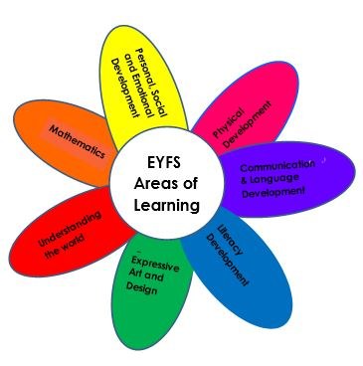




Early Years Curriculum
Topics!
Autumn
Marvellous Me!
What’s the Weather?
Spring
Helping Hands
What is Spring?
Summer
Awesome Oceans
What a Wonderful World!

Slide 7
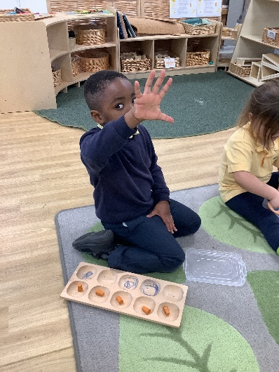
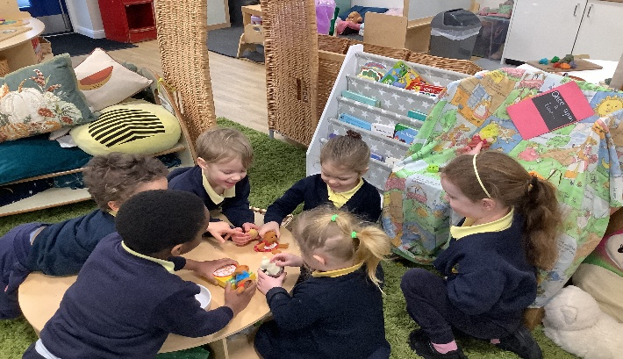
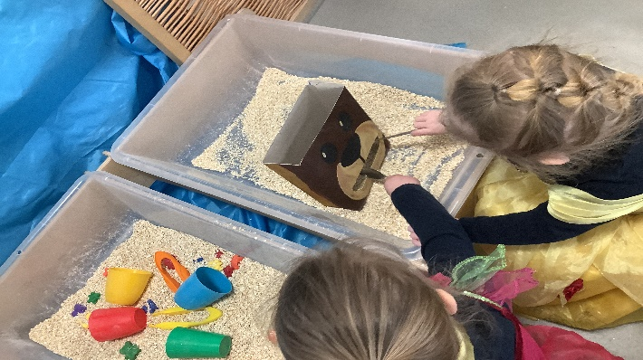
Our EYFS unit
Our classroom is split up into zones that cover all areas of learning. Children have access to all of these over the course of the day, inside and outside.
Children select and use resources independently and then move on to new ones, with or without adult intervention.
Our policy for ensuring that resources are cared for:
Choose it Use it Put it away

