Slide 1

Spark the Flame Curriculum Overview

Slide 2
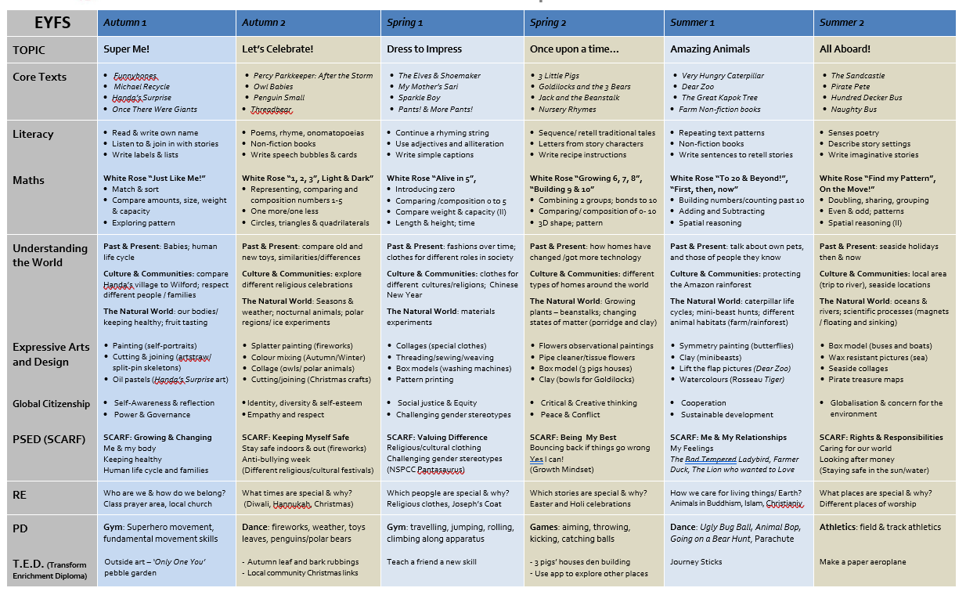

Slide 3
History Focus: Medieval Britain (monarchs)
History Focus: When did humans arrive? Stone Age

Slide 4
Yr2 | Autumn Term DISCOVER |  | Spring term EXPLORE |  | Summer Term BELONG
Global curriculum elements Overview | FIRE AND FEVER Great Fire of London The Great Plague Exploring how different social groups were affected by the fire. https://theschooltrip.co.uk/resources/mol-great-fire-1666-interactive-story/ How were the poor and rich impacted differently? The Gunpowder plot Link to Boots the Chemist- Nottingham Tudor and Stuart Britain | Vlad and the great fire of London Raven Boy | HUMANS V ANIMALS Are humans more important than animals? British and world wildlife How is wildlife impacted by growth of cities, houses being built, roads? What is more important, growth of economy or animals? God’s beautiful creation- What would God say about endangered animals? Conservation Farming- Should we be vegetarians? Battery chickens v free range etc Why do we eat some animals and not others? Religion and food- which animals are sacred and why? What is kosher and Halal? Study the impact of humans on our global wildlife population. Declining number of species and how organisations work on this. This will be balanced by studying how people are driven to use hunting, poaching and farming to survive. Consider the impact of conservation on the native tribes who live in the areas affected- Masai? Learn about animal welfare in UK- RSPCA. How is their approach different to the rangers in Africa. | The Hunter We will miss them | WORLD PARTY Celebrations around the world- what do they mean and why are they celebrated? Festivals, traditions, carnivals How do people around the world celebrate what is important to them? Children to learn about the similarities and differences in the way different people celebrate festivals. Which festivals are important to particular religions and the customs linked to them. History Focus: How Christmas and other Celebrations were influenced by the Victorians. Look at Victorian life and compare with now. The festival of midsummer in Sweden- compare to traditional May day celebrations that used to take place across the UK. Festivals linked to the bible- why do Jews celebrate Hannukah? Why do Muslims celebrate EID etc. | Happiness is a watermelon Kasias Surprise Let’s celebrate- Festival poems Proudest Blue
 | Social Justice and Equity Human Rights Power and Governance Empathy Respect for people Ability to manage complexity and uncertainty | Science: Uses of everyday materials | Sustainable development Empathy Communication Informed and reflective action Concern for the environment and commitment to sustainable devt Belief that people can bring about change Ability to manage complexity and uncertainty | Science: Living things and life cycles (Habitats, food chains, identification of plants and animals) | Identity and diversity Social justice and equality Communication Sense of identity Respect for people and human rights Commitment to participation and inclusion | Science: Plants and animals inc humans (Seeds, basic needs, exercise)

Slide 5
Yr3 | Autumn Term DISCOVER |  | Spring term EXPLORE |  | Summer Term BELONG
Global curriculum elements Overview | PLACE INVADERS Vikings Link to modern invasion of countries- Afghanistan etc Impact on people and where they live. What did Britain gain from the Viking invasion? Is invasion of a country always a bad thing? Study of Septimus Severus- An African born emperor who died in York. https://artsandculture.google.com/story/5-forgotten-black-and-asian-figures-who-made-british-history/wAICKqOAzVvtJw Anglo Saxons – who were they? What happened when the Vikings arrived. When were the Romans in Britain? Were the Vikings religious? | Odd and the frost giants The House at the edge of Magic | THE GREAT FOOD DEBATE Should we all be vegetarians? What is the impact of eating meat on our environment? What about vegan? Supermarket plastic. Food shortages, supermarket and restaurant waste, farms, over-fishing, exporting food v local produce, harbours, trade links, minerals and distribution of natural resources. Look at the impact that fair trade has had on the lives of farmers in Africa and central America. Will there ever be a need to consider a fair trade policy in UK? What is the financial impact of importing food from around the world. Use of insecticides on farms. Looking at the different multi-cultural food in Britain. What are the differences, staple diets, range of foods used? Remind about festival foods from Year 2- What is kosher, Halal etc. How does food reflect identity. | The Boy who biked the world From farm to fork CharlotteWeb | FASHION FORWARD Sustainablity in clothes- should we spend more on quality, re-use, mend? When was ‘make do and mend’ a slogan and why?- mend own clothes in class. Impact of fast fashion on the environment- How are these clothes so cheap? What is the impact on those working to make the clothes in other countries? Sharewear charity drive- raise money and collect clothes for the charity. History Focus: Benin Kingdom – how did they become so powerful through trade. Compare their desire for power and wealth with countries today. What significance did clothing have in Benin? Cultural appropriation- what does this mean? Do you agree? Fashion designers- local Paul Smith. Nottingham Castle museum. | Bills new frock Rosie revere engineer Julian is a mermaid I love my hair
 | Peace and conflict Human rights Power and governance Globalisation and interdependence Sense of identity Social justice and equity Co-operation and conflict resolution | Science: Light (Reflection, shadows, need for light) Forces and magnets | Globalisation and interdependence Sustainable development Power and governance Communication Informed and reflective action Concern for the environment Commitment to sustainable development Belief that people can bring about change | Science: Plants and animals (Life cycle of plants, nutrition, skeleton, muscles) | Identity and diversity Human rights Critical and creative thinking Self awareness and reflection Sense of identity Respect for people and human rights Value diversity | Science: Living things and their habitats: Classification, changing climate and it’s impact

Slide 6
Yr4 | Autumn Term DISCOVER |  | Spring term EXPLORE |  | Summer Term BELONG
Global curriculum elements Overview | CITIES AT WAR Focus on the impact of WW2 on Nottingham (local history Study) Could there ever be a war like this again? What was the impact on Nottingham? How are today’s wars different? What about refugees?- How do refugees today compare to evacuees in WW2? Holocaust- Why did this prejudice exist and do we still see prejudice today? Is war always the wrong decision- What would God say about war? Is killing in war the same as murder? What makes it lawful? Where do we see conflict today- How did propaganda impact Britain during the war- How do we see propaganda in the modern day? How do we know what to believe in the media? | Letters from the Lighthouse Rose Blanche | STORY OF A RIVER River Trent- compare with another river in Europe Mechanics of river formation- erosion etc Flooding- why does it happen and are we seeing more flooding? Why could that be? Look at flood defences in Wilford Village- Bee bank What is the impact of flooding on local communities, wildlife etc? Where do we see flooding across the world and why? Field work with NES students Environment agency link Study of the Ganges- What is the importance of the river to Hindus? How does the river influence the way they live? https://www.bbc.co.uk/teach/class-clips-video/geography-ks3-the-ganges-in-india-/zmjrkmn Hong Kong- How do people in Hong Kong use the river? What spiritual meaning does the river have in some faiths? | Song of the dolphin boy Wind in the Willows | SETTLE DOWN Refugees, travellers (Roma), Shelters Why do people leave their homes? Seek refuge from different things (war, poverty, famine, violence in the home, desire to travel) Indigenous people- should we leave them alone? History Focus: local history study – civil war in Newark and its effect on the people of Britain. Could there ever be another civil war? Look at other civil wars: Syria, Bosnia, Rwanda Homelessness- William Booth and the salvation army Refugee camps- Calais Care homes, foster carers Islamophobia- different groups within religions. Why are some people afraid of religions. | Christophe’s story The Arrival The Boy at the back of the class
 | Social Justice and equity Globalisation and interdependence Peace and conflict Human rights Power and governance Communication Co-operation and conflict resolution Ability to manage complexity and uncertainty Respect for people and human rights | Science: Sound Electricity | Sustainable development Empathy Communication Informed and reflective action Concern for the environment and commitment to sustainable development Belief that people can bring about change Ability to manage complexity and uncertainty | Science: Solids, liquids and gases. Rocks and Fossils | Social justice and equity Identity and diversity Peace and conflict Human rights Respect for people and human rights | Science: Animals inc humans (Digestive system, teeth, food chains)

Slide 7
Yr5 | Autumn Term DISCOVER |  | Spring term EXPLORE |  | Summer Term BELONG
Global curriculum elements Overview | THE SPACE RACE Historical space race- which countries were involved? Why was it important to them? Who owns space? International relations. What was happening in US at the time? Is it a waste of money exploring space? Should we be preparing to live on another planet? Look at women and diversity in space exploration. What does the bible say about the universe? What about science? Could both have elements of truth? Watch https://www.youtube.com/watch?v=X1rPalyUshw | Cosmic Hidden Figures The Moon (RLS) | FRAGILE EARTH Continents- plate tectonics North and South poles, Latitude/Longitude Looking at different biomes, Mountains and climates. Volcanoes and earthquakes Natural disasters- Wild fires, flooding (Link back to Year 4), Which are natural and which are caused by human influence? Frackimg- what is the impact? Wind farms- Why are there more? What about when they are built near residential areas? Map work How does religion encourage people to help bring about positive change? | King of the Cloud Forest Jungle Book When the Mountain Roared The Tyger (WB) | THE STEREOTYPE CHALLENGE Why do we have stereotypes? Different types of stereotyping- religious, gender, mental health, disability, age, faith etc. How does this impact where people work, what they do?, pay etc? History Focus - Stone Age to space age . A timeline focus to understand chronological human development. What was life like in the stone age? How long did it last? How did the iron age change life? Create visual representation of human history, marking the most significant moments. Look back at fashion forward topic and how people dress- should we wear what we want? How do we discriminate against different groups of people- those with disabilities? How do we include everyone in the world. Do we have an inclusive approach in our school. Could we improve this? Difference between equity and equality Who are we aware of that have a disability? Paralympics, How have women been discriminated against in the past? Does it still happen? Female referees, top jobs, pay differences. What about black discrimination- football managers, teachers? | Wonder
 | Globalisation and interdependence Peace and conflict Power and governance Communication Ability to manage complexity and uncertainty | Earth and Space Forces | Sustainable devt Concern for the environment Belief that people can bring about change Ability to manage complexity and uncertainty | Evolution and adaptation Living things and habitats (Classification) | Social justice and equity Identity and diversity Human rights Self awareness and reflection Respect for people and human rights Valuing diversity Commitment to participation and inclusion Belief that people can bring about change | Properties and changes of materials (Reversible changes etc)

Slide 8
Yr6 | Autumn Term DISCOVER |  | Spring term EXPLORE |  | Summer Term BELONG
Global curriculum elements Overview | DIGGING FOR TREASURE The Greeks- Ownership of world treasures- museums, The Elgin Marbles. Is slavery a thing of the past?- Explore modern day slavery and how this compares to the role of the slaves in Ancient Greece. How were women viewed by the Greeks? Consider myths and legends and how women were portrayed. Sappho- female poet who wrote about romantic love between women. Sappho’s poem to Aphrodite. Link to Y3- Multiple religions in Ancient Greece. Why did they believe in more than one God? Which religions do this today? Are myths and legends religious? Romans – comparison with another Empire. How did they impact Britain. Who was the most powerful/successful? Who was Septimus Severus? Were they at the same time? | Greek Myths & legends Percy Jackson The girl of ink and stars Who let the Gods out The Highwayman | OCEANS APART Pollution of the sea. Danger to sea life. Climate change (Seas getting warmer, melting ice caps, rising sea level- link to flooding in year 4) Indigenous people, coral reefs, Knowledge of the 5 main oceans. Study the impact of luxury in the Maldives https://www.bbc.co.uk/news/world-asia-16072020 The importance of clean water. What happens to plastic in this country? Is it right that we send it to other countries to deal with? Consider the roles of underpaid Chinese workers in recycling industry. Their children play with toys they find in the rubbish- how would you feel? https://www.theguardian.com/environment/2019/aug/17/plastic-recycling-myth-what-really-happens-your-rubbish What are the positives of recycling- what can be made out of our plastic? What would God say about how humans are polluting the planet? | Orphans of the Tide Floodland | WE ALL MATTER Fighting for equality, particularly for ethnic minorities. Human rights and the unicef rights of the child UN convention on rights of the child Case study- Yemen. Understanding the value and importance of diversity in UK Stories of those in our community who have experienced discrimination. People who have spoken out against discrimination and racism. Charities and organisations who support anti racism and anti discrimination. History Focus: in Depth study of Ancient Egypt – slavery and human rights. Year 6 project | The unforgotten coat Kick The other side of truth If the world were a village
 | Social justice and equity Globalisation and interdependence Peace and conflict Human rights Power and governance Communication and conflict resolution Ability to manage complexity and uncertainty Respect for people and human rights | Light Electricity | Sustainable development Concern for the environment Commitment to participation Belief that people can bring about change Ability to manage complexity and uncertainty | Animals inc humans( Circulation system, diet, drugs, lifestyles) Living things and their habitats) | Social justice and equity Identity and diversity Human rights, power and governance Empathy Communication Informed and reflective action Sense of identity Commitment to social justice and equity Respect for people and human rights Value diversity Commitment to participation and inclusion | Living things and their habitats Animals inc humans- reproduction. Changes Life cycles

Slide 9
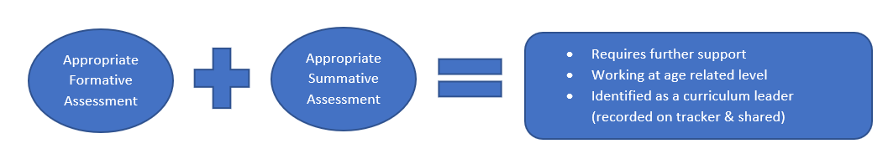
Assessment across the curriculum
Subject | Formative Assessment | Summative Assessment
Science DT Geography History RE PSHE Computing | Sticky 7 Quizzes Mind Maps – What do you know? Questioning (DISCO)] Oracy activities – debate/discussion Experiments/Tests Mini Quizzes Accessing age related texts Self-Assessment docs Book work | Half termly ‘Sticky Quiz’ in books End of unit quiz (Socrative) Revisit Mind Maps Completed Project – end of unit outcome Digital Journal Presentational Talk Assessment grid completed
PE | Observation Practical demonstration Peer evaluation Self- Assessment / Video / pictures | Competition Demonstration Performance Progression of skills Assessment grid completed
Art Music | In class observation Application of Skills Understanding of Art form Ideas and creativity | Final outcome Performance Assessment grid completed
French/MFL | Questioning Oracy activities – conversation / paired Mini Quizzes Call and response Dualingo | End of unit Assessment (quiz) Assessment grid completed

