Slide 1




BHM Writing Competition

Slide 2
Black History Month
Black History Month is an annually observed commemorative month originating in the United States, where it is also known as African-American History Month.
It is celebrated in February in the USA and Canada, where it has received official recognition from governments, but more recently has also been celebrated in the United Kingdom where it is observed in October.
This year’s theme is ‘reclaiming narratives’, which aims to acknowledge the actions of black people, who might otherwise have been forgotten.

Slide 3
This month…
During the first 2 weeks of October, Black History month, you will be hearing from 10 black, local leaders, who will be sharing their inspirational stories via videos.
They will tell their stories and talk about what has inspired them. You teachers will be showing you these in class.

Slide 4
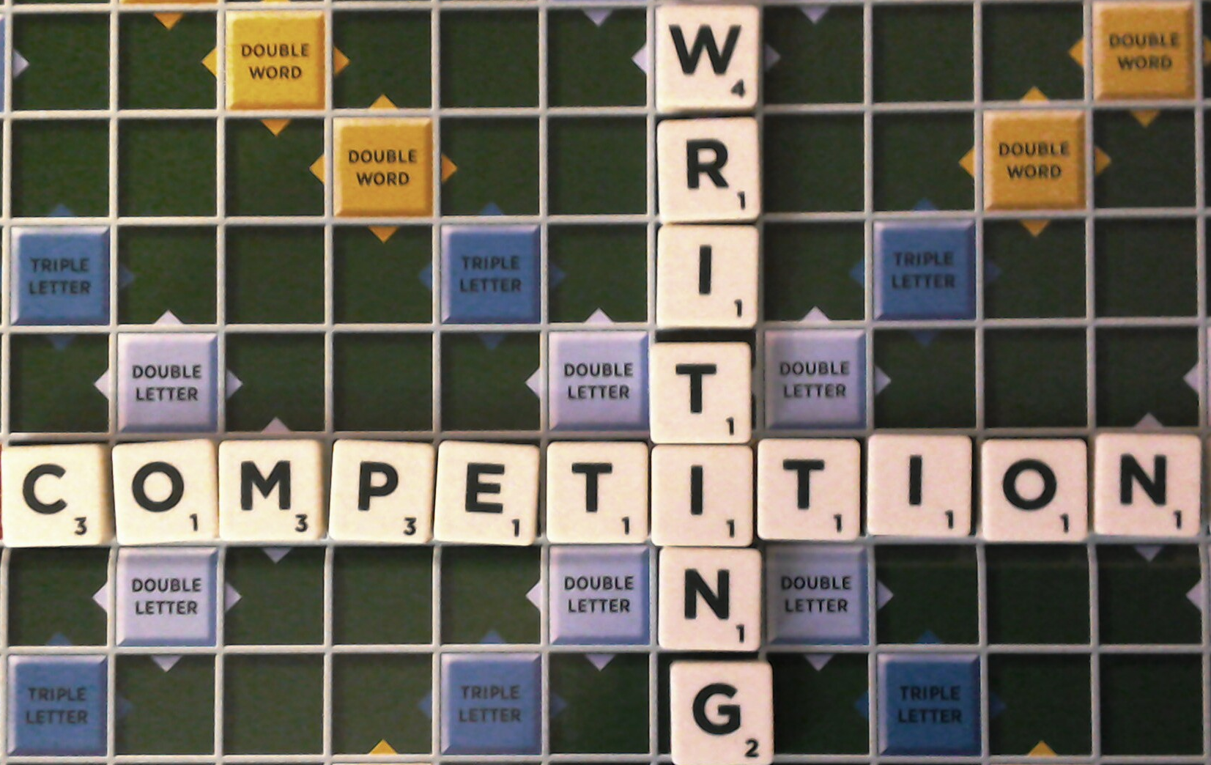
Writing competition
We will all be joining in by doing a piece of writing about an inspirational black person.
You will find out who your class is focussing on from your teacher!
You will be doing this in your English lessons in the final week of term.

Slide 5
Your writing could be…
A biography, a fact file, a story, a poster, a short video or even an interview.
What is inspiring about this person? What would you want others to know about them? You could include some key dates from their life and a photo.
It can be hand-written or done on a device.

Slide 6
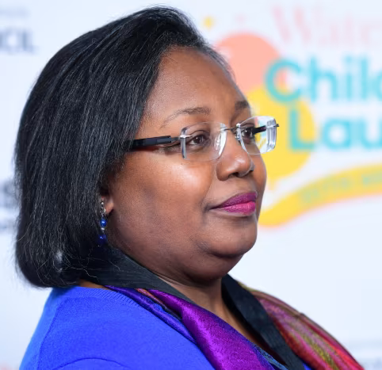
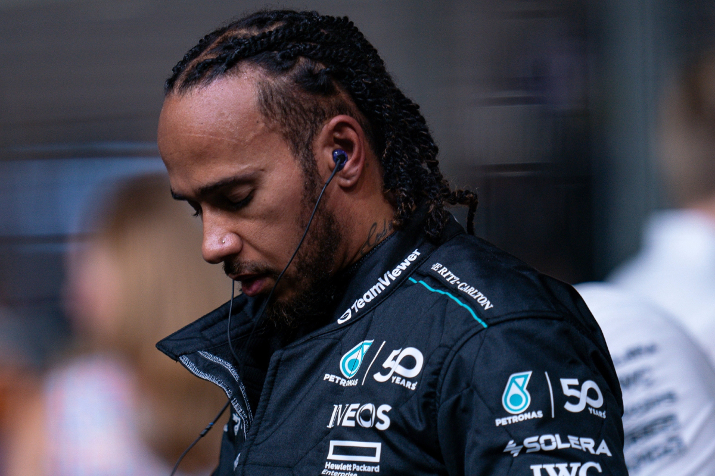
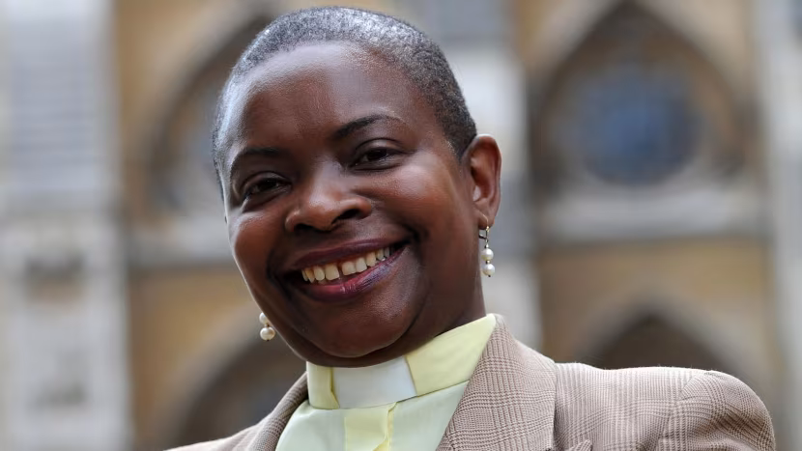
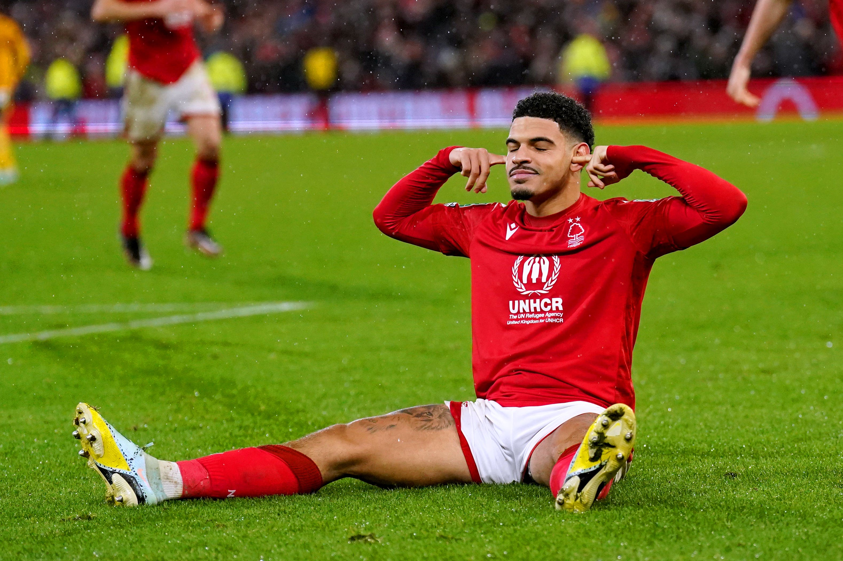
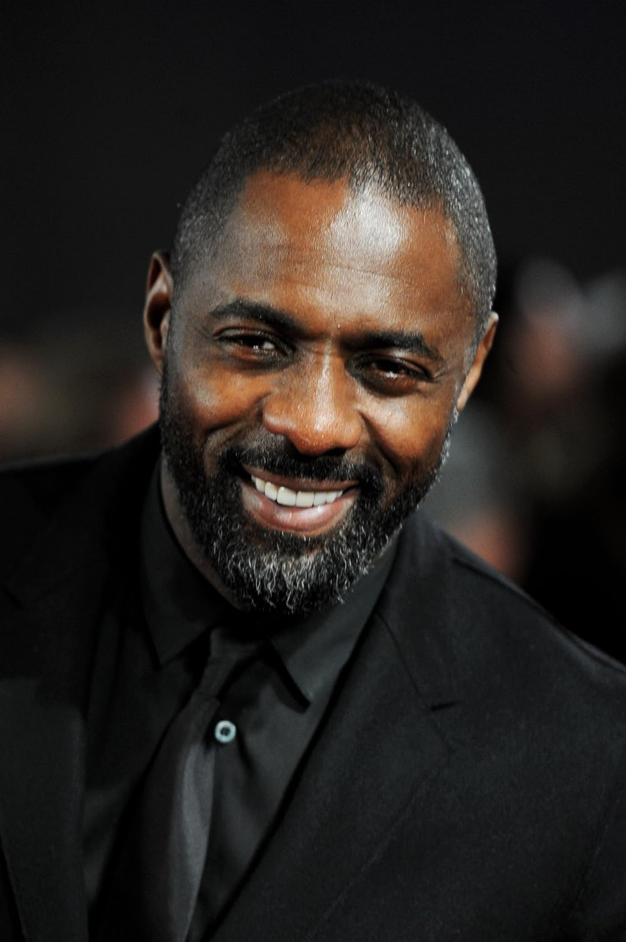
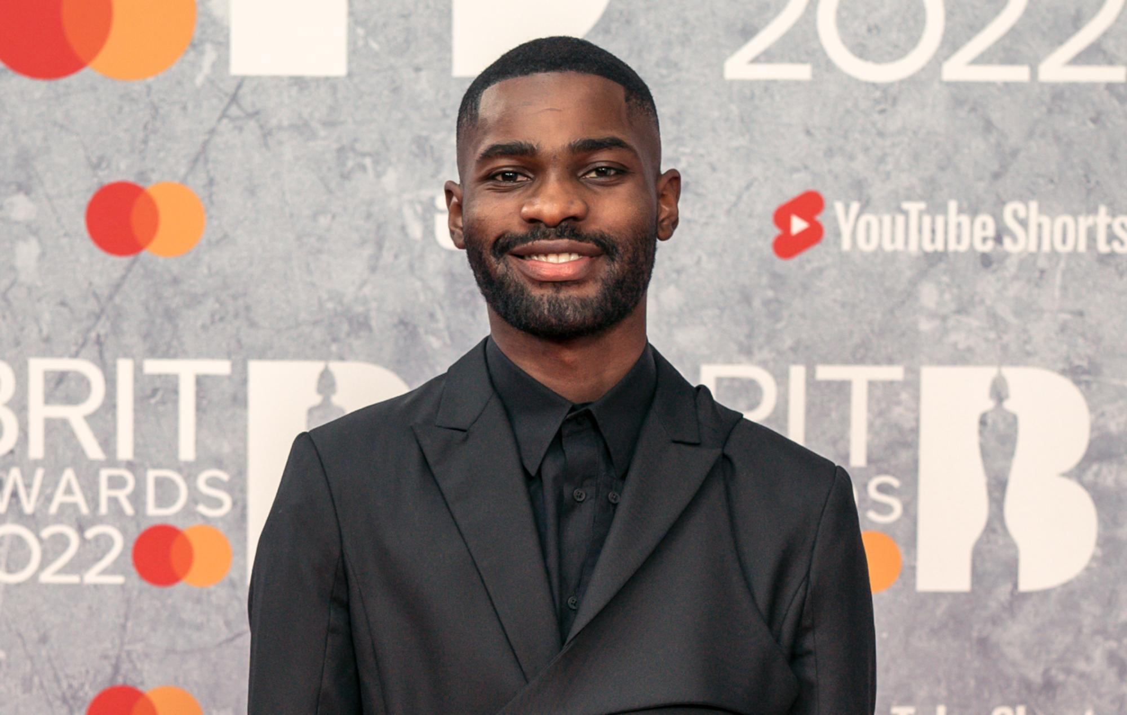
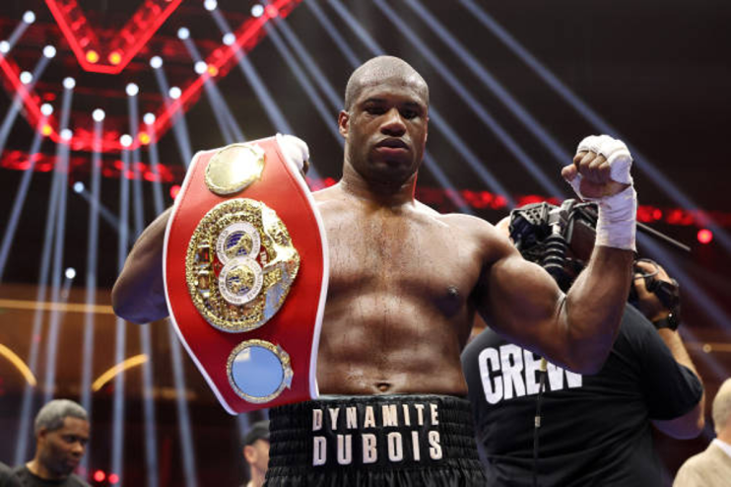
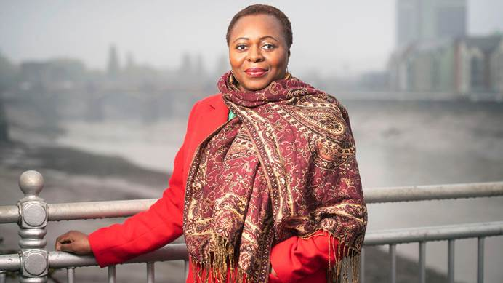
Inspirational ideas
Bishop Rose Hudson-Wilkin
Morgan Gibbs-White
Lewis Hamilton
Malorie Blackman
Santan Dave
Daniel Dubois
Olivette Otele
Idris Elba

Slide 7
Prizes
There will be a Transform Trust prize for:
EYFS, Key Stage 1, Lower Key Stage 2 (Y3 and Y4) and Upper Key Stage 2 (Year 5 and 6).
Writing curriculum councillors and class teachers will be helping to choose the best pieces in our school for prizes too!
We can’t wait to see what you produce.

