Slide 1
Geography
South Wilford C of E Primary School
Subject Lead: J Gill
Curriculum leaders: Jude S (Y6), Lizzie Potter (Y4)

Slide 2
Intent
Our aim at South Wilford is to provide a rich and exciting Geography curriculum where the children will flourish through their pursuit of excellence. The curriculum challenges, inspires and motivates all children to be knowledgeable, curious and critical about our world and to recognise the importance of sustainable development for the future of humankind. We aim to give all children a deep understanding of their local area and an awareness of their responsibilities to be inspired to protect this and the wider environment. Through comparing our human and physical geography with other regions in the United Kingdom, Europe and the wider world, children will acquire critical thinking skills, local knowledge and pride in their community as well as respect and appreciation for varying cultures. Through drawing and interpreting maps, children will develop their creativity through the skills of research, investigation, analysis and problem-solving. Exceptional wider opportunities including visits, visitors and STEM experiences will create awe and wonder, igniting their enthusiasm and belief that they can have a lasting impact on the future. Cross-curricular links to our English topics and rich, varied texts in Shared Reading will ensure that children know more and remember more.

Slide 3
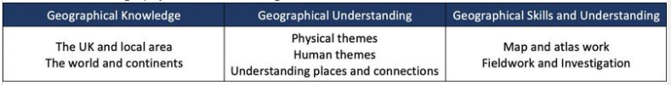
Implementation
At South Wilford, we carefully plan for progression from Early Years, where Geography is part of ‘Understanding the World’, through to KS2 and beyond. Our teaching and learning promotes a depth of understanding on Geographical themes, through cross-curricular topics which link to National Curriculum guidance for Geography and the Oxfam Global Citizenship Education. These are closely tailored to the vision and context our school, whereby all children have an understanding and appreciation of how they can enact and lead positive change in the world. Through Shared Reading and English lessons, rich Geographical texts are read, discussed and analysed to deepen pupils’ understanding. This is then supported by carefully planned cross-curricular links within and across year groups to create a challenging 3D curriculum for our learners.
In KS1 and KS2, Geography is delivered through 3 strands:

Slide 4
LEARNING
Progression
In Early Years, Geography is part of ‘Understanding the World’. Children can compare places, talk about their immediate environment, make observations and explain why some things occur or change.
In Years 1 and 2, children should develop their knowledge about the world, the United Kingdom and their locality. They should understand basic subject-specific vocabulary relating to human and physical geography. They will begin to ‘think like a geographer’, using subject specific skills such as using aerial photos, maps, simple compass directions and first-hand observation, to enhance their locational awareness.
In Key Stage 2, children will extend their knowledge and understanding beyond the local area to include the United Kingdom and Europe, North and South America. This will include the location and characteristics of a range of the world’s most significant human and physical features, considering how these have changed through time. As they move into upper Key Stage 2, children will focus on the impact we have on our changing world and the consequences of this, focusing on how we can enact positive change in our world.

Slide 5
LEARNING
Adapted approaches to learning:
Early Years – play maps and small world equipment. Drawing pictures and maps of known/imaginary landscapes. Children compare places.
KS1 – Age appropriate atlases, games and apps on iPads. Inflatable globe games. Opportunities to draw maps, e.g. story maps, maps of local area, world maps. Weather station.
KS2 – Age appropriate atlases, games and apps on iPads. Globes and maps of varying scales, including OS Maps. Newsround.

Slide 6
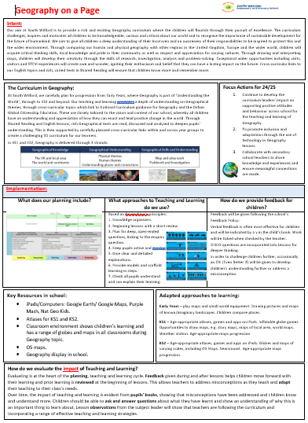
Subject on a page

Slide 8
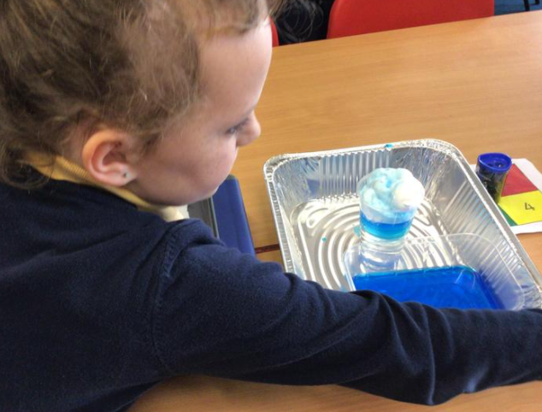
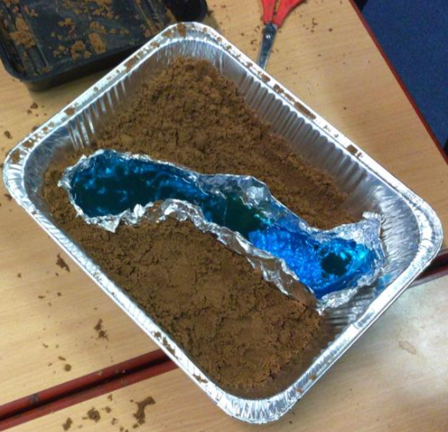
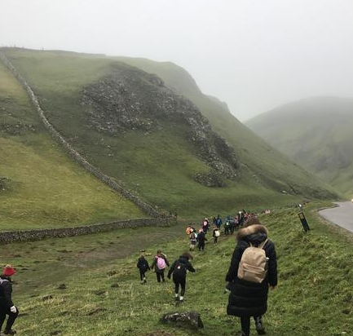
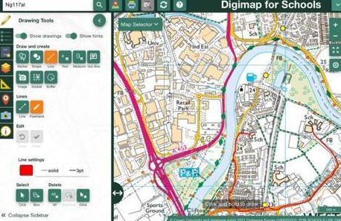
Exceptionality Flourishing!
Using technology - Digimaps, Google Earth
Experiments - creating rivers and watercycles
Trips – Mam Tor
Visitors – Severn Trent Water

Slide 9
Pupil Voice
“I have enjoyed learning about human and physical geography and how I can help to look after the environment”
“Geography has helped me to understand why floods happen and what can be done to help protect against them.”

Slide 10
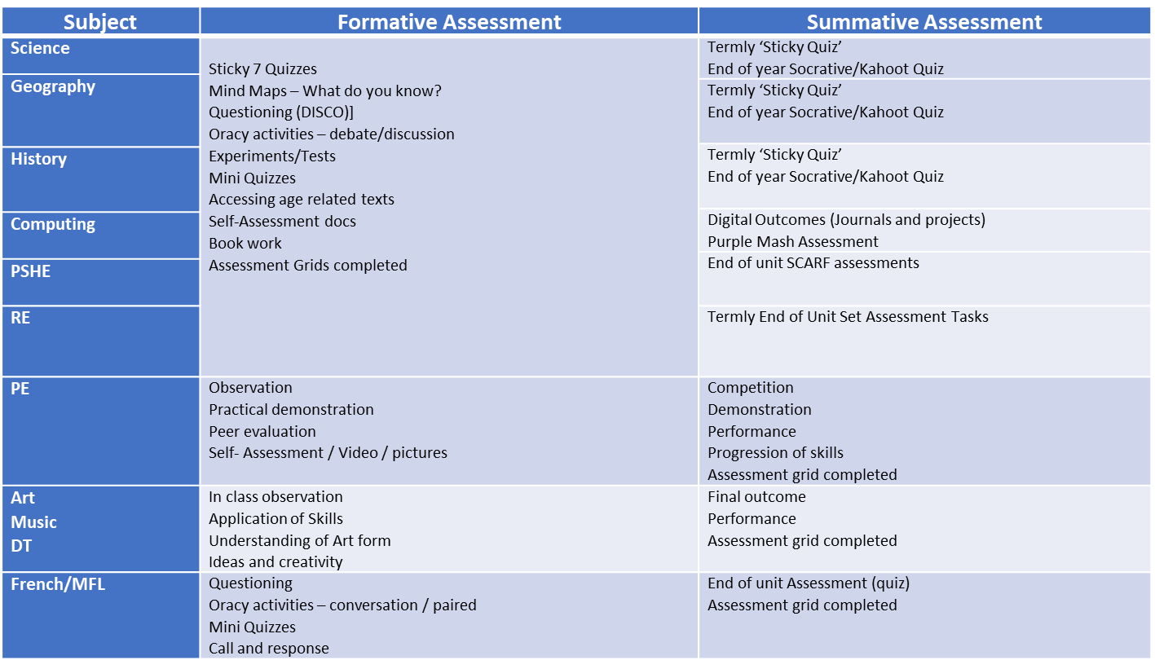
Assessment

Slide 11
Supporting everyone
Challenging: high expectations for all children (DISCO) challenging curriculum
Diversity: representation for all within the curriculum through range of musicians, instruments and genres
Inclusive: ensuring all children can access the curriculum
Accessible: opportunities for all children
Enrichment: music, sport, drama, trips, visitors, experiences
Support/Stretch: TA, scaffolding, Quality First teaching, Arc
Wellbeing: Brighter Futures, ELSA

