Slide 1


Calculation guidance for written methods of addition

Slide 2
Y1

Slide 3
Proposed teaching sequence
Combining objects – work through all number bonds within 10
Fact families for number up to 10
Number bonds to 10
Counting on
Number bonds to 20
Add by making 10
Represent and use number bonds to 20

Slide 4
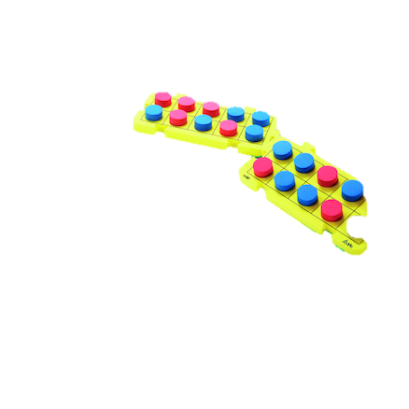
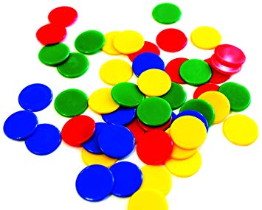
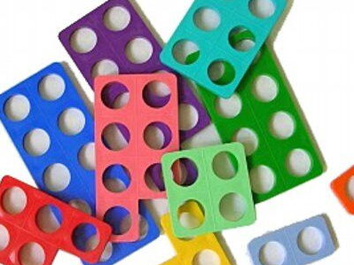

Revisit | NC objectives
Children should be able to: count up to 20; place numbers in order count objects accurately; write numbers; know what is one more and one less; add one digit number from another up to 5 | Pupils should be taught to: read, write and interpret mathematical statements involving addition (+) and equals (=) signs represent and use number bonds and related addition facts within 20 add one-digit and two-digit numbers to 20, including zero solve one-step problems that involve addition, using concrete objects and pictorial representations, and missing number problems
Resources

Slide 5

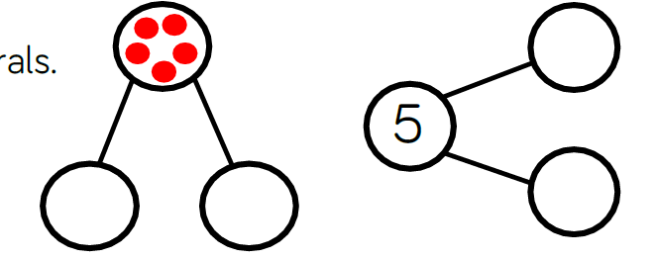
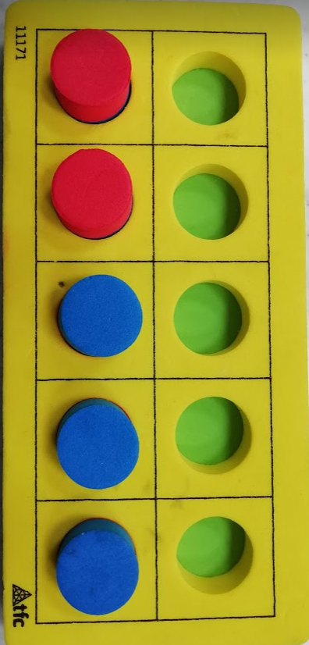
NC Objective: add one-digit and two-digit numbers to 20, including zero |  |  | Small Step: Combining objects within 10
Vocabulary: add, more, and make, sum, total, altogether, one more, two more, ten more… how many more to make… ? how many more is… than…? Plus, how much more
Representations + |  | Misconceptions
 |  | Sometimes they are unsure of number order and therefore make mistakes.
 |  | Sometimes they count their starting number e.g. when finding the number pair 6 + - = 10 they begin counting with the six and say ‘6,7,8,9,10’ and therefore believe the missing number to be 5
 | Counters/cubes/bead string | Not being able to ‘hold’ the number that they started with, when adding the second group.
 |  | End Goal

Slide 6
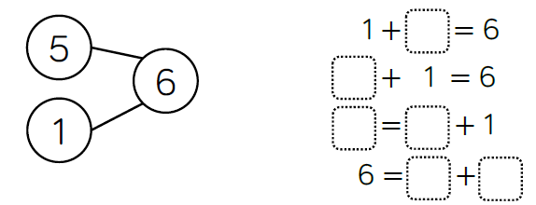
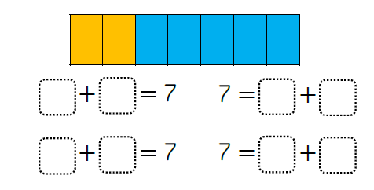
NC Objective: represent and use number bonds and related addition facts within 20 |  |  | Small Step: Fact families for number up to 10
Vocabulary: add, more, and make, sum, total, altogether, one more, two more, ten more… how many more to make… ? how many more is… than…? Plus, how much more
 |  | Misconceptions
 |  | Sometimes they are unsure of number order and therefore make mistakes.
 |  | Sometimes they count their starting number e.g. when finding the number pair 6 + - = 10 they begin counting with the six and say ‘6,7,8,9,10’ and therefore believe the missing number to be 5
3 + 2 = 5 2 + 3 = 5 5 = 3 + 2 5 = 2 + 3 |  | Not being able to ‘hold’ the number that they started with, when adding the second group.
 |  | End Goal

Slide 7

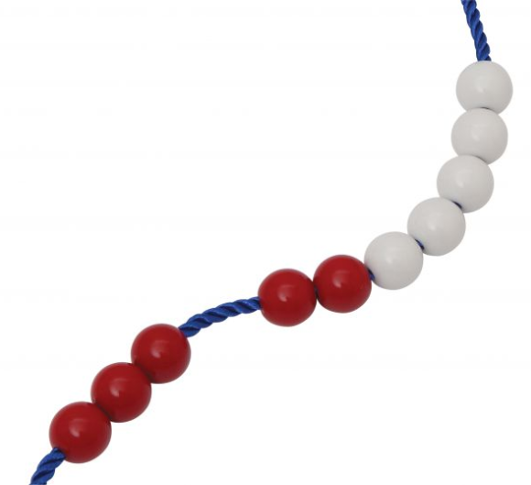
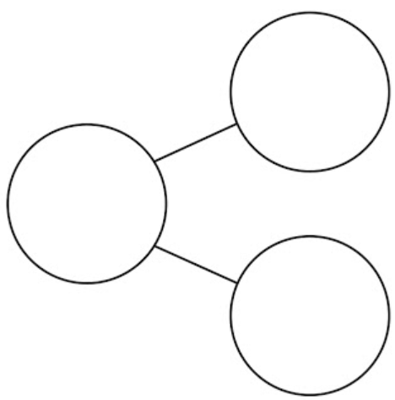
NC Objective: represent and use number bonds and related addition facts within 20 |  |  | Small Step: Number bonds to 10
Vocabulary: add, more, and make, sum, total, altogether, one more, two more, ten more… how many more to make… ? how many more is… than…? Plus, how much more
7 + 3 = 10 | 5 + 5 = 10 | Misconceptions
 |  | Sometimes they are unsure of number order and therefore make mistakes.
 |  | Sometimes they count their starting number e.g. when finding the number pair 6 + - = 10 they begin counting with the six and say ‘6,7,8,9,10’ and therefore believe the missing number to be 5.
6 + 4 = 10 |  | Not being able to ‘hold’ the number that they started with, when adding the second group.
 |  | End Goal
10
8
6
4
10
2

Slide 8
NC Objective: represent and use number bonds and related addition facts within 20 |  |  | Small Step: Add by making 10
Vocabulary: add, more, and make, sum, total, altogether, one more, two more, ten more… how many more to make… ? how many more is… than…? Plus, how much more
7 + 5 = 12 |  | Misconceptions
 |  | Sometimes they are unsure of number order and therefore make mistakes.
 |  | Sometimes they count their starting number e.g. when finding the number pair 6 + - = 10 they begin counting with the six and say ‘6,7,8,9,10’ and therefore believe the missing number to be 5
 |  | Not being able to ‘hold’ the number that they started with, when adding the second group.
 |  | End Goal:
7 + 5 = 12
12
7
3
2
12
7
5
+3
+2
7
10
12

Slide 9



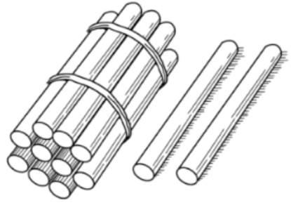
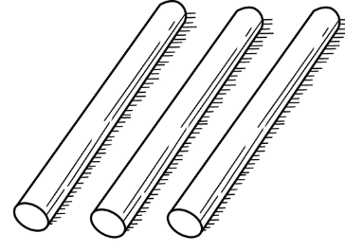
NC Objective: add one-digit and two-digit numbers to 20, including zero |  |  | Small Step: Combining objects between 10 and 20
Vocabulary: add, more, and make, sum, total, altogether, one more, two more, ten more… how many more to make… ? how many more is… than…? Plus, how much more
Representations + |  | Misconceptions
 |  | Sometimes they are unsure of number order and therefore make mistakes.
 |  | Sometimes they count their starting number e.g. when finding the number pair 6 + - = 10 they begin counting with the six and say ‘6,7,8,9,10’ and therefore believe the missing number to be 5
 |  | Not being able to ‘hold’ the number that they started with, when adding the second group.
 |  | End Goal
 | + 3 Link to 10 + (2+3)
15
10
3
2

Slide 10
Y2

Slide 11
Proposed teaching sequence
Commutative law of addition
Number bonds to 100 (multiples of 10)
Adding 1s no exchanging
Adding 1s exchanging
Adding three 1-digit numbers
Adding 10 more
Adding multiples of 10
Adding TO + O no exchanging
Adding TO + O exchanging
Adding TO + TO no exchanging
Adding TO + TO exchanging
Number bonds to 100

Slide 12
Revisit | NC objectives
Number bonds to 10 Partition numbers Adding to next multiple of 10 | solve problems with addition and : using concrete objects and pictorial representations, including those involving numbers, quantities and measures applying their increasing knowledge of mental and written methods recall and use addition facts to 20 fluently, and derive and use related facts up to 100 add and numbers using concrete objects, pictorial representations, and mentally, including: a two-digit number and ones a two-digit number and tens two two-digit numbers adding three one-digit numbers show that addition of two numbers can be done in any order (commutative) recognise and use the inverse relationship between addition and subtraction and use this to check calculations and solve missing number problems.
Resources

Slide 13
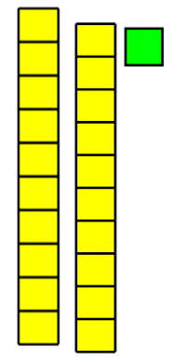
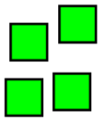
NC Objective: show that addition of two numbers can be done in any order |  |  | Small Step: Commutative law
Vocabulary: as Year 1 and addition, commutative, order, first
Representations + = + |  | Misconceptions Children believe that numbers must be added in the order in which the appear in the question.
 |  | End Goal Given a set of three numbers, children can demonstrate and explain when addition is commutative. There are also able to spot which numbers should be added together first when faced with more than two numbers to add together.
 | + 21 + 4 = 4 + 21
15
13
2
15
2
13
15
13
2
15
2
13

Slide 14
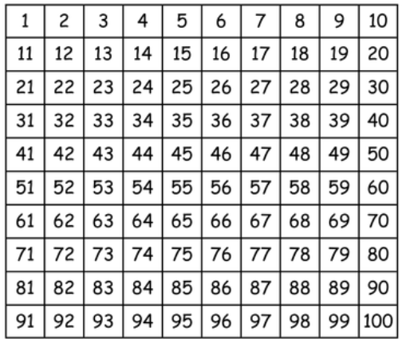
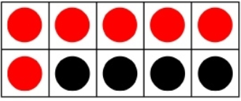
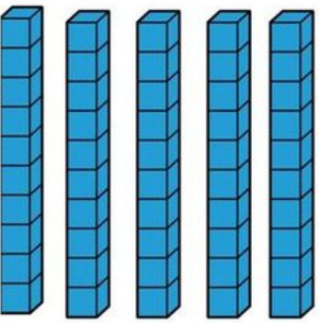
NC Objective: recall and use addition facts to 20 fluently, and derive and use related facts up to 100 |  |  | Small Step: Number bonds to 100
Vocabulary: as Year 1 and addition, 100 more
Representations |  | Misconceptions Children don’t understand the link to place value.
 |  | End Goal Children can quickly recall all pairs of multiples of 10 that add together to make 100
+
100
60
40
10
6
4

Slide 15
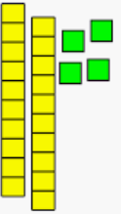

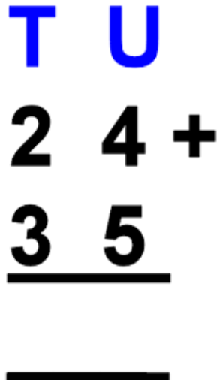
NC Objective: add and numbers using concrete objects, pictorial representations, and mentally, including a two-digit number and ones |  |  | Small Step: adding 1s no exchanging
Vocabulary: as Year 1 and addition, 100 more
Representations +5 24 29 Making link between 4 + 5 and 10 + 5 |  | Misconceptions Children count on using the starting number twice, once in their head and once on their fingers. Children aren’t secure in their place value knowledge
 |  | End Goal Children can use known facts to quickly recall unknown facts
+
29
24
5

Slide 16
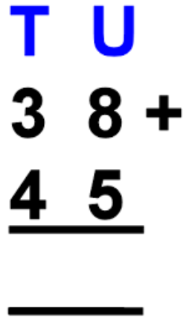
NC Objective: add and numbers using concrete objects, pictorial representations, and mentally, including a two-digit number and ones |  |  | Small Step: adding 1s exchanging
Vocabulary: as Year 1 and addition, 100 more
Representations + 2 +3 38 40 43 |  | Misconceptions
 |  | End Goal
+
43
38
2
3

Slide 17
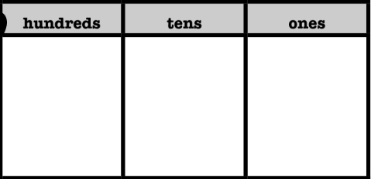
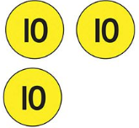

NC Objective: add and numbers using concrete objects, pictorial representations, and mentally, including a two-digit number and ones |  |  | Small Step: Adding 10
Vocabulary:
Representations |  | Misconceptions
 |  | End Goal
+ =
4 3
+ 1 0
5 3

Slide 18
NC Objective: add and numbers using concrete objects, pictorial representations, and mentally, including a two-digit number and ones |  |  | Small Step: Adding multiples of 10
Vocabulary: as Year 1 and addition, 100 more
Representations |  | Misconceptions
 |  | End Goal
+ =
4 3
+ 3 0
7 3

Slide 19
NC Objective: add and numbers using concrete objects, pictorial representations, and mentally, including a two-digit number and ones |  |  | Small Step: Adding TO and TO with no exchanging
Vocabulary: as Year 1 and addition, 100 more
Representations + Both physical and drawn | +20 +3 36 56 59 | Misconceptions
 |  | End Goal
3 6 + 2 3 9 (6+3) 5 0 (30+20) 5 9
3 6
+ 2 3
5 9

Slide 20
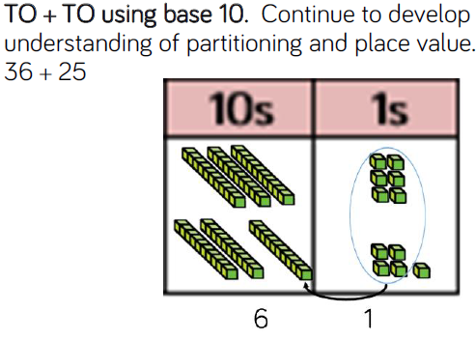
NC Objective: add and numbers using concrete objects, pictorial representations, and mentally, including a two-digit number and ones |  | Small Step: Adding TO and TO with exchanging
Vocabulary: as Year 1 and addition, 100 more
Representations |  | Misconceptions
 |  | End Goal
+20 +5 36 56 61
3 6 + 2 5 1 1 (6+5) 5 0 (30+20) 6 1
3 6
+ 2 5
6 1
¹

Slide 21
Y3

Slide 22
Proposed teaching sequence
Add one
Add ten
Add one hundred
Add 1s
Add 10s
Add 100s
Estimate an answer
HTO + TO no exchange
HTO + HT no exchange
HTO + HTO with one exchange
HTO + HTO with two exchanges
Solve problems involving addition

Slide 23
Revisit | NC objectives
Number bonds to 10 Partition numbers Adding to next multiple of 10 Adding TO and TO using a range of representations | add numbers mentally, including: a three-digit number and ones a three-digit number and tens a three-digit number and hundreds add numbers with up to three digits, using formal written methods of columnar addition estimate the answer to a calculation and use inverse operations to check answers solve problems, including missing number problems, using number facts, place value, and more complex addition.
Resources

Slide 24
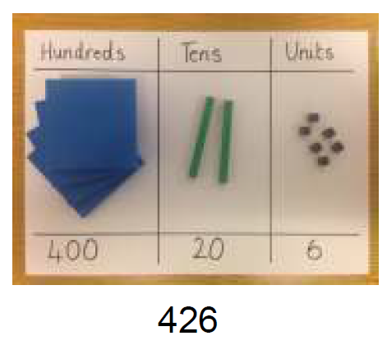
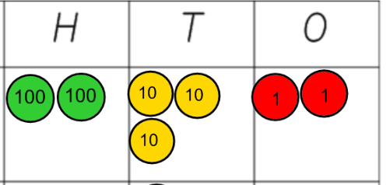
NC Objective: |  |  | Small Step: Adding 1, 10 and 100
Vocabulary:
Representations Children to partition numbers to add 1, 10 and 100 mentally |  | Misconceptions
 |  | End Goal
232 +100 332

Slide 25
NC Objective: |  |  | Small Step: Adding multiples of 1, 10 and 100
Vocabulary:
Representations Children to partition numbers to add 1, 10 and 100 mentally |  | Misconceptions
 |  | End Goal
232 +100 332

Slide 26
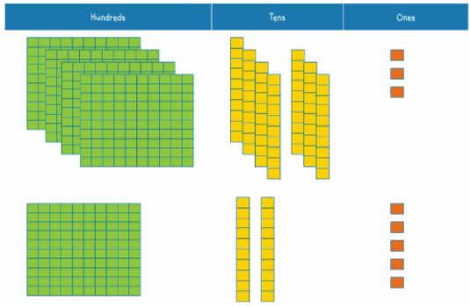
NC Objective: |  |  | Small Step: Adding HTO and TO no exchanging
Vocabulary:
 |  | Misconceptions
 |  | End Goal
473 + 125 3 + 5 = 8 70 + 20 = 90 400 = 400 498 | 473 + 25 498
Using Base Ten or place value both practically and as pictures.

Slide 27
NC Objective: |  |  | Small Step: Adding HTO and HTO no exchanging
Vocabulary:
 |  | Misconceptions
 |  | End Goal
473 + 125 3 + 5 = 8 70 + 20 = 90 400 + 100 = 500 598 | 473 +125 598
Using Base Ten or place value both practically and as pictures.

Slide 28
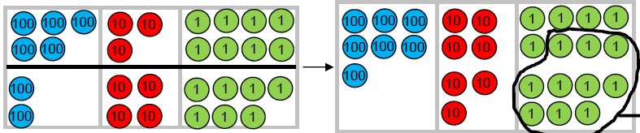
NC Objective: |  |  | Small Step: Adding HTO and TO one exchange
Vocabulary:
538 + 247 8 + 7 = 15 30 + 40 = 70 500 = 500 585 | 538 + 47 585 ¹ | Misconceptions
 |  | End Goal
With place value or base ten both practically and in pictures

Slide 29
NC Objective: |  |  | Small Step: Adding HTO and HTO one exchange
Vocabulary:
538 + 247 8 + 7 = 15 30 + 40 = 70 500 + 200 = 700 785 | 538 +247 785 ¹ | Misconceptions
 |  | End Goal
With both place value and base ten

Slide 30
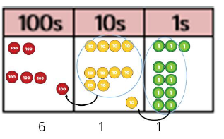
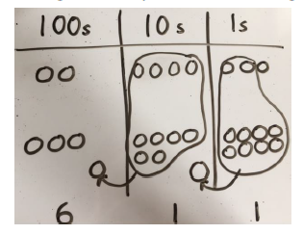

NC Objective: |  |  | Small Step: Adding HTO and TO two exchanges
Vocabulary:
 |  | Misconceptions
 |  | End Goal
243 + 68 311 ¹ | 243 + 68 3 + 8 = 11 40 + 60 = 100 200 200 311
3
3

Slide 31
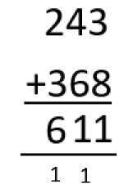
NC Objective: |  |  | Small Step: Adding HTO and HTO two exchanges
Vocabulary:
 |  | Misconceptions
 |  | End Goal
 | 243 + 268 3 + 8 = 11 40 + 60 = 100 200 + 300 = 500 611

Slide 32
Y4-6

Slide 33
Follow Y3 sequence starting at HTO add HTO before progressing to larger numbers

