Slide 1


Calculation guidance for written methods of subtraction

Slide 2
Y1

Slide 3
Proposed teaching sequence
How many left – Numbers up to 10
Counting back – Numbers up to 10
Finding the difference - Numbers up to 10

Slide 4
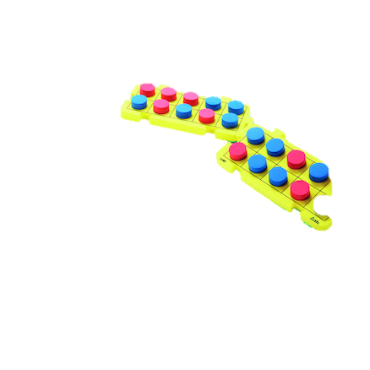
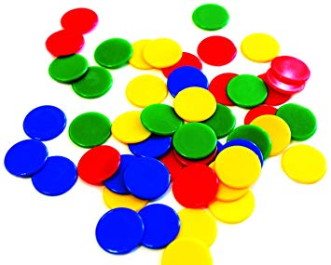
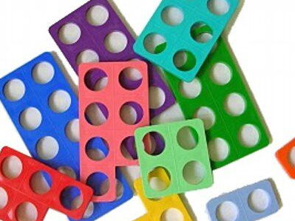

Revisit | NC objectives
Children should be able to: count up to 20; place numbers in order count objects accurately; write numbers; know what is one more and one less; subtract one digit number from another | Pupils should be taught to: read, write and interpret mathematical statements involving subtraction (–) and equals (=) signs represent and use number bonds and related subtraction facts within 20 subtract one-digit and two-digit numbers to 20, including zero solve one-step problems that involve subtraction, using concrete objects and pictorial representations, and missing number problems such as 7 =
Resources

Slide 5
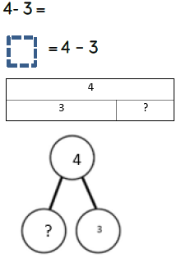
NC Objective: Subtract one-digit and two-digit numbers to 20, including zero |  |  | Small Step: How many left - Numbers up to 10
Vocabulary: take away less than the difference subtract minus fewer decrease
Representations Children to draw the concrete resources they are using and cross out the correct amount. The bar model can also be used. |  | Misconceptions Not realising that numbers can be counted in order forwards and backwards.
 |  | End Goal solve one-step problems that involve addition and subtraction, using concrete objects and pictorial representations, and missing number problems such as 7 = ? - 9
Physically taking away and removing objects from a whole (ten frames, Numicon, cubes and other items such as beanbags could be used).

Slide 6
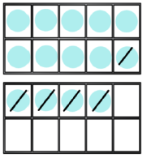
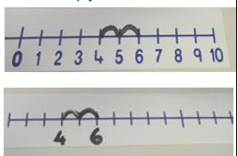
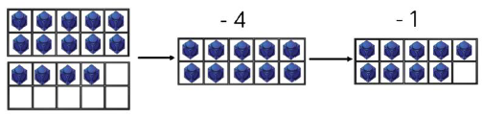
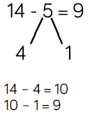
NC Objective: Subtract one-digit and two-digit numbers to 20, including zero |  |  |  | Small Step: Counting back – numbers up to 10
Vocabulary: take away less than the difference subtract minus fewer decrease
Representations |  |  | Misconceptions Not realising that numbers can be counted in order forwards and backwards.
 |  |  | End Goal solve one-step problems that involve addition and subtraction, using concrete objects and pictorial representations, and missing number problems such as 7 = ? - 9
Counting back (using number lines or number tracks) children start with 6 and count back 2.
Counting back
Children to present the ten frame pictorially and discuss what they did to make 10.
Making 10 using ten frames.
14 – 5
Counting back continuing to partition the subtrahend

Slide 7
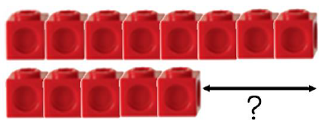
NC Objective: Subtract one-digit and two-digit numbers to 20, including zero |  |  | Small Step: Finding the difference – numbers up to 10
Vocabulary: take away less than the difference subtract minus fewer decrease
Representations | Finding the difference (using cubes, Numicon or Cuisenaire rods, other objects can also be used). Calculate the difference between 8 and 5. | Misconceptions Pupils might not understand the concept of ‘finding a difference’. This is largely due to the fact that they can count on or back and are unsure which method to choose.
 |  | End Goal solve one-step problems that involve addition and subtraction, using concrete objects and pictorial representations, and missing number problems such as 7 = ? - 9
Children to draw the cubes/other concrete objects which they have used or use the bar model to illustrate what they need to calculate.

Slide 8
Y2

Slide 9
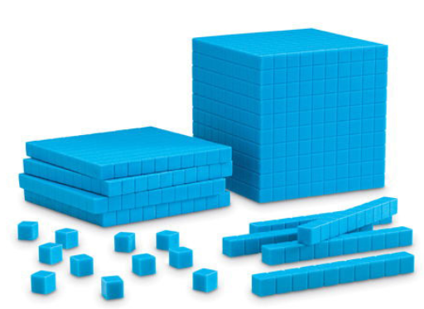
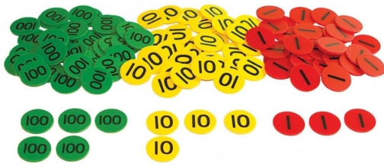
Revisit | NC objectives
Children should be able to: Understand PV of numbers; Use of number track subtract one digit number from another mentally from and within 20; | Pupils should be taught to: solve problems with subtraction: using concrete objects and pictorial representations, including those involving numbers, quantities and measures applying their increasing knowledge of mental and written methods recall and use subtraction facts to 20 fluently, and derive and use related facts up to 100 subtract numbers using concrete objects, pictorial representations, and mentally, including: a two-digit number and ones a two-digit number and tens two two-digit numbers adding three one-digit numbers
Resources

Slide 10
Proposed teaching sequence
Ten less
Subtract multiple of 10
TO – O no exchanging
TO – TO no exchanging
TO – TO exchanging

Slide 11
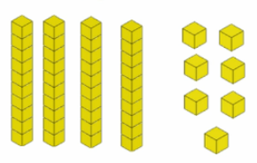
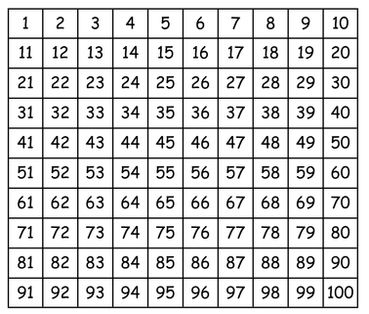
NC Objective: solve problems with subtraction: using concrete objects and pictorial representations, including those involving numbers, quantities and measures applying their increasing knowledge of mental and written methods recall and use subtraction facts to 20 fluently |  |  | Small Step: Ten Less
Vocabulary: take away less than the difference subtract minus fewer decrease
Representations Use base 10 to physically take away |  | Misconceptions Subtractions involving zeros cannot be done.
 |  | End Goal Children can mentally subtract 10 from any two digit number
Use base 10 picture to cross out correct amount
48
10
?

Slide 12
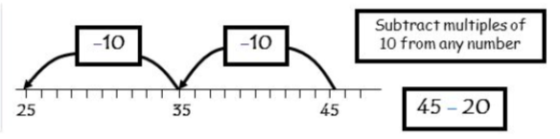
NC Objective: using concrete objects and pictorial representations, including those involving numbers, quantities and measures applying their increasing knowledge of mental and written methods |  |  | Small Step: Subtract multiple of 10
Vocabulary: take away less than the difference subtract minus fewer decrease
Representations |  | Misconceptions Pupils not understanding the value of each digit in a number
 |  | End Goal Children can mentally count back in tens from any given two-digit number
Use base 10 picture to cross out correct amount
Use base 10 to physically take away
48
20
?

Slide 13
NC Objective: using concrete objects and pictorial representations, including those involving numbers, quantities and measures applying their increasing knowledge of mental and written methods |  |  | Small Step: TO – O no exchanging
Vocabulary: take away less than the difference subtract minus fewer decrease
Representations |  | Misconceptions Pupils sometimes begin subtracting with the left hand column first.
 |  | End Goal Children can set questions out in a formal column and subtract without use of fingers i.e. by making use of knowledge of known facts and place value.
Use base 10 to physically take away
Use base 10 picture to cross out correct amount
48
7
?
Use number line to make link between 8-7 and 18-7, 28-7 etc

Slide 14
NC Objective: using concrete objects and pictorial representations, including those involving numbers, quantities and measures applying their increasing knowledge of mental and written methods |  |  | Small Step: TO – TO no exchanging
Vocabulary: take away less than the difference subtract minus fewer decrease
Representations |  | Misconceptions Pupils sometimes begin subtracting with the left hand column first. Misconceptions occur when pupils (and teachers) use inaccurate language. e.g. 27 - 15 When talking about 20 – 10 they may refer to it as 2 – 1.
 |  | End Goal Children can set questions out in a formal column and subtract without use of fingers i.e. by making use of knowledge of known facts and place value.
Use base 10 picture to cross out correct amount
Use base 10 to physically take away
48
7
?
Use number line to make link between 8-7 and 18-7, 28-7 etc

Slide 15
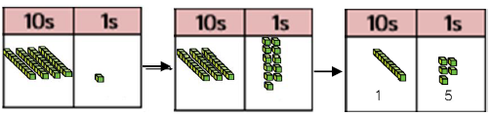
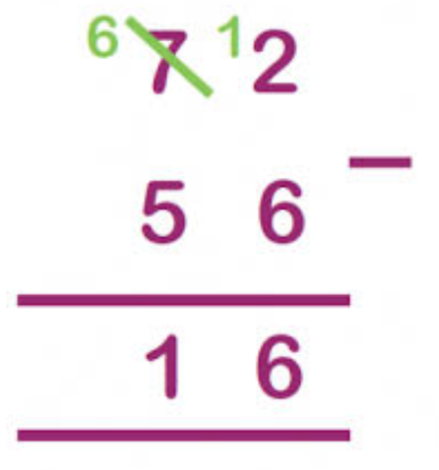
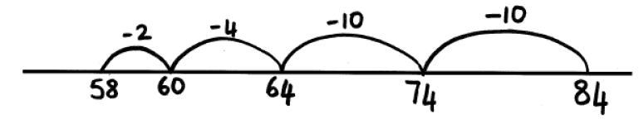
NC Objective: using concrete objects and pictorial representations, including those involving numbers, quantities and measures applying their increasing knowledge of mental and written methods |  |  | Small Step: TO – TO exchanging
Vocabulary: take away less than the difference subtract minus fewer decrease
Representations |  | Misconceptions In tens and units and other formal vertical subtraction calculations, children sometimes take the smaller unit number from the larger, regardless of whether it is part of the larger or smaller number. e.g. 45 - 37 12
 |  | End Goal
Use base 10 picture to cross out correct amount
41 – 26 = 15 using base ten and regrouping
41
26
?
84 - 26

Slide 16
Y3

Slide 17
Revisit | NC objectives
Children should be able to: Understand PV of numbers; Mentally subtract a multiple of 10 Use formal column subtraction including exchanging for TO - TO | Subtract numbers mentally, including: a three-digit number and ones a three-digit number and tens a three-digit number and hundreds Subtract numbers with up to three digits, using formal written methods of columnar addition and subtraction estimate the answer to a calculation and use inverse operations to check answers solve problems, including missing number problems, using number facts, place value, and more complex subtraction.
Resources

Slide 18
Proposed teaching sequence
100 less
Subtract multiples of 100
HTO – O no exchanging
HTO – TO no exchanging
HTO – HTO no exchanging
HTO – O exchanging from tens to ones column
HTO – TO exchanging from hundreds to tens column
HTO – HTO with one exchange
HTO – HTO with two exchanges
HTO – HTO with one exchange, one number to include 0.

Slide 19
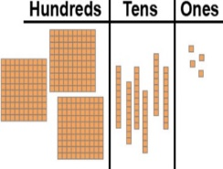

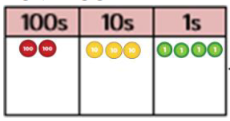
NC Objective: Subtract numbers mentally, including: a three-digit number and ones, tens and hundreds |  |  | Small Step: 100 less
Vocabulary: take away less than the difference subtract minus fewer decrease
Representations |  | Misconceptions Pupils not understanding the value of each digit in a number
 |  | End Goal Children can mentally subtract 100 from any three-digit number
Children draw their own PV table and counters to represent the number before crossing out as appropriate
Use base 10 to physically take away, setting out in PV table
PV counters set out table 748 –100 = ?
354 454 554 654 754
Continue to make use of blank number lines and reinforce PV
754 – 400 or 754 - 300

Slide 20
NC Objective: Subtract numbers mentally, including: a three-digit number and ones, tens and hundreds |  |  | Small Step: Subtract Multiples of 100
Vocabulary: take away less than the difference subtract minus fewer decrease
Representations |  | Misconceptions Pupils not understanding the value of each digit in a number
 |  | End Goal Children can mentally count back in hundreds from any given three-digit number
Children draw their own PV table and counters to represent the number before crossing out as appropriate
Use base 10 to physically take away, setting out in PV table
PV counters set out table 748 –300 = ?
754
?
400
Continue to make use of blank number lines and reinforce PV
754 – 400 or 754 - 300
354 454 554 654 754

Slide 21

NC Objective: Subtract numbers with up to three digits, using formal written methods of columnar addition and subtraction |  |  | Small Step: Subtracting without exchanging
Vocabulary: take away less than the difference subtract minus fewer decrease
Representations | Use picture of base 10 and PV counters 257 - 123 | Misconceptions Pupils sometimes begin subtracting with the left hand column first. Misconceptions occur when pupils (and teachers) use inaccurate language. e.g. 27 - 15 When talking about 20 – 10 they may refer to it as 2 – 1.
 | 763 - 251
 |  | End Goal Children can subtract numbers up to three digits using Formal column method where appropriate.
Use base 10 to physically take away, setting out in PV table
PV counters set out table 748 –237 = ?
700 + 60 + 3
- 200 + 50 + 1

Slide 22
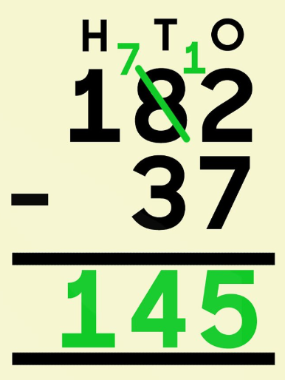
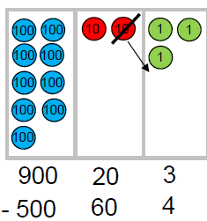
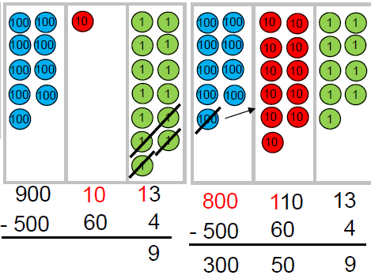
NC Objective: |  | Small Step: Subtracting with exchanging
Vocabulary: take away less than the difference subtract minus fewer decrease
Representations |  |  | Misconceptions Pupils sometimes begin subtracting with the left hand column first. Misconceptions occur when pupils (and teachers) use inaccurate language. e.g. 27 - 15 When talking about 20 – 10 they may refer to it as 2 – 1.
 |  |  | End Goal Children can subtract numbers up to three digits using Formal column method where appropriate.
Use physical PV counters and base ten and pictures of both to represent subtraction | Use base 10 to physically take away, setting out in PV table, exchanging where necessary

Slide 23
Y4

Slide 24
Revisit | NC objectives
Children should be able to: Understand PV of numbers; Use of number track subtract one digit number from another mentally from and within 20; | subtract numbers with up to 4 digits using the formal written methods of columnar addition and subtraction where appropriate estimate and use inverse operations to check answers to a calculation solve addition and subtraction two-step problems in contexts, deciding which operations and methods to use and why.
Resources

Slide 25
Proposed teaching sequence
1000 less use of base ten
ThHTO – multiple of 10/100/1000
ThHTO – TO no exchanging
ThHTO – HTO no exchanging
ThHTO – ThHTO no exchanging
ThHTO – TO with one exchange
ThHTO – HTO with one exchange
ThHTO – ThHTO with one exchange
ThHTO – TO with two exchanges
ThHTO – HTO with two exchanges
ThHTO – ThHTO with two exchanges

Slide 26
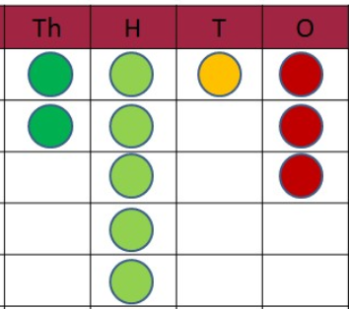
NC Objective: |  | Small Step: 1000 less
Vocabulary: take away less than the difference subtract minus fewer decrease
Representations | Misconceptions Pupils not understanding the value of each digit in a number
 | End Goal
Use PV counters to physically take away, setting out in PV table
2513 - 1000
Children draw their own PV table and counters to represent the number before crossing out as appropriate
2513
-1000
2513
1000
?

Slide 27
NC Objective: |  | Small Step: Subtract Multiples of 1000
Vocabulary: take away less than the difference subtract minus fewer decrease
Representations | Misconceptions
 | End Goal
PV counters set out table 7141 –3000 = ?
Children draw their own PV table and counters to represent the number before crossing out as appropriate
7141
?
3000
Continue to make use of blank number lines and reinforce PV
7141 – 3000
4141 5141 6141 7141

Slide 28
NC Objective: |  | Small Step: Subtracting without exchanging
Vocabulary: take away less than the difference subtract minus fewer decrease
Representations | Misconceptions Children line up the numbers incorrectly due to misconceptions around place value Children don’t see the calculation as a whole which will lead to further misconceptions when exchanging is involved
 | End Goal Children can lay questions out correctly in column subtractions format and answer correctly.
PV counters set out table and remove counters 2513 - 1402
Use picture of base 10 and PV counters
3257 - 1123
3763
- 1251
3000 + 700 + 60 + 3
- 1000 + 200 + 50 + 1

Slide 29
NC Objective: | Small Step: Subtracting with exchanging
Vocabulary: take away less than the difference subtract minus fewer decrease
Representations |  | Misconceptions Pupils may subtract the smaller digit in a column from the larger digit, regardless of which appears in the top line. This can arise if they hear that, “for subtraction you always start with the bigger number and subtract the smaller number”. Not understanding the role of 0 as a place holder so when face with 0-7 they answer 0
 |  | End Goal Subtract using formal written method of subtraction
Use physical PV counters and base ten, exchanging where necessary
Children draw their own PV table and counters to represent the number before crossing out as appropriate

Slide 30
Y5 and 6
Children in Year 6 should continue to develop their mental and written calculation
methods for subtraction. They should progress to larger numbers and
continue calculating with decimals, including those with different numbers of decimal
places.
Please see the Year 5 (or earlier) calculation policy for more information about the
written strategies for subtraction they should use.

Slide 31
Revisit | NC objectives
Children should be able to: Understand PV of numbers; Use of number track subtract one digit number from another mentally from and within 20; | subtract whole numbers with more than 4 digits, including using formal written methods (columnar addition and subtraction) subtract numbers mentally with increasingly large numbers use rounding to check answers to calculations and determine, in the context of a problem, levels of accuracy solve subtraction multi-step problems in contexts
Resources

Slide 32
Proposed teaching sequence
1000 less
ThHTO – multiple of 10/100/1000
ThHTO – TO no exchanging
ThHTO – HTO no exchanging
ThHTO – ThHTO no exchanging
ThHTO – TO with one exchange
ThHTO – HTO with one exchange in both columns
ThHTO – ThHTO with one exchange in all columns
ThHTO – HTO with two exchanges
ThHTO – ThHTO with two exchanges

Slide 33
NC Objective: |  | Small Step: Subtracting without exchanging
Vocabulary: take away less than the difference subtract minus fewer decrease
Representations | Misconceptions Children line up the numbers incorrectly due to misconceptions around place value Children don’t see the calculation as a whole which will lead to further misconceptions when exchanging is involved
 | End Goal Children can lay questions out correctly in column subtractions format and answer correctly.
PV counters set out table and remove counters 2513 - 1402
Use picture of base 10 and PV counters
3257 - 1123
3763
- 1251
3000 + 700 + 60 + 3
- 1000 + 200 + 50 + 1

Slide 34
NC Objective: | Small Step: Subtracting with exchanging
Vocabulary: take away less than the difference subtract minus fewer decrease
Representations |  | Misconceptions Pupils may subtract the smaller digit in a column from the larger digit, regardless of which appears in the top line. This can arise if they hear that, “for subtraction you always start with the bigger number and subtract the smaller number”. Not understanding the role of 0 as a place holder so when face with 0-7 they answer 0
 |  | End Goal Subtract using formal written method of subtraction
Use physical PV counters and base ten, exchanging where necessary
Children draw their own PV table and counters to represent the number before crossing out as appropriate

