Slide 1


Calculation guidance for written methods of multiplication

Slide 2
Y1

Slide 3
Proposed teaching sequence
Make equal groups of 2
Make equal groups of 5
Make equal groups of 10
Count in 2s
Count in 5s
Count in 10s

Slide 4

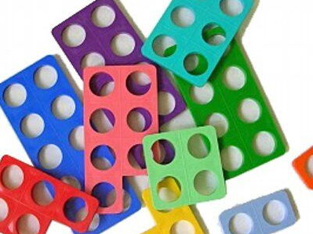
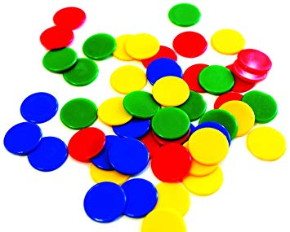
Revisit | NC objectives
Children should be able to: count up to 20; count objects accurately; write numbers; | Pupils should be taught to: solve one-step problems involving multiplication, by calculating the answer using concrete objects, pictorial representations and arrays with the support of the teacher.
 | Vocabulary Groups Lots of Repeated addition Array Times Rows Columns
Resources

Slide 5



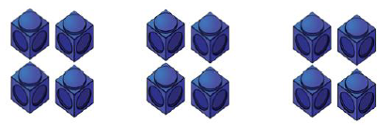
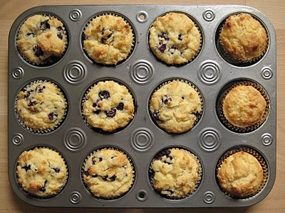
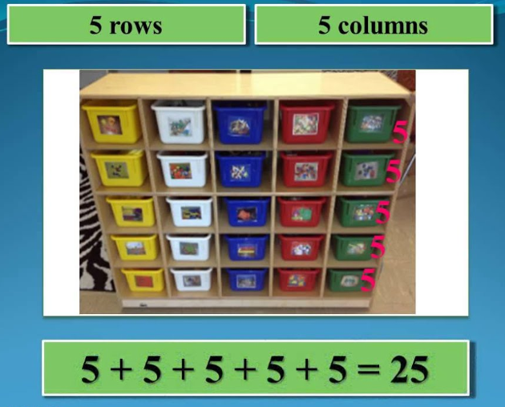
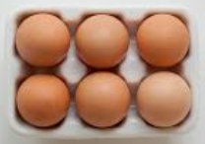

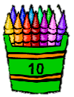
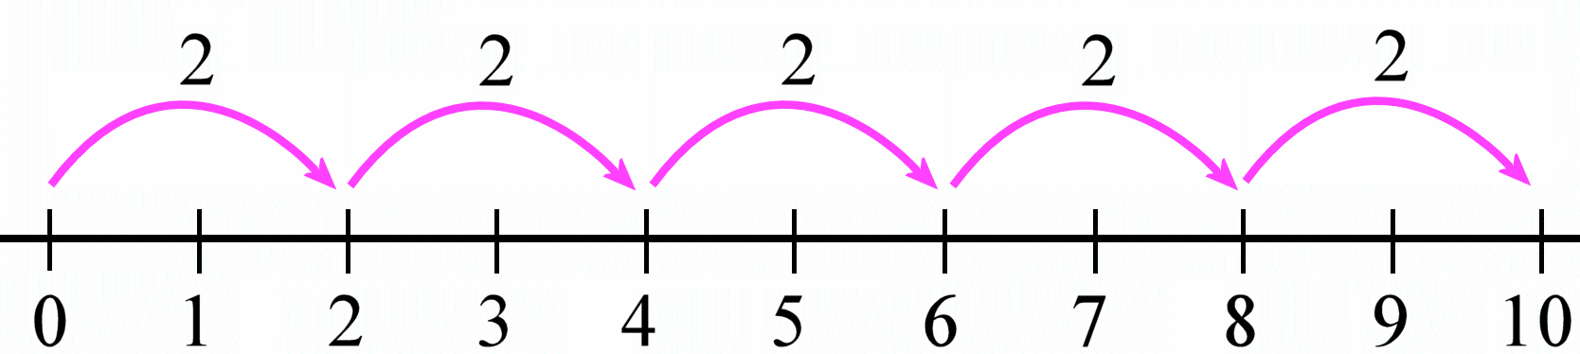
Recognise and make equal group | Objects to be place on top of the number line to aid counting | Children to represent the practical resources in a picture and use a bar model. | Children to represent the calculation as repeated addition 2 + 2 + 2 + 2 = 8
Children to represent the array as repeated addition and identify commutative law 2 + 2 + 2 + 2 + 2 = 10 5 + 5 = 10 | Children draw arrays to show commutative law of multiplication | # Use arrays to highlight the commutative law of multiplication | Children notice arrays in real life and make using object
Children use real life objects to solve problems | Children to represent answers to real life problems on number line | Children to solve real life problems using arrays and link to bar model | Children to show answers to real life problems as repeated addition

Slide 6
End Goal
solve one-step problems that involve multiplication using concrete objects, pictorial representations and repeated additions
Children can count mentally in 2s, 5s and 10s

Slide 7
Y2

Slide 8
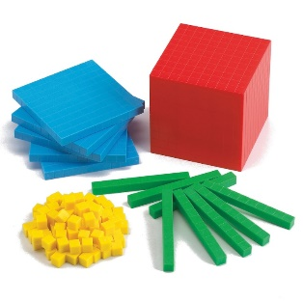
Revisit | NC objectives
Children should be able to: Recognise an array Count mentally in multiples of 2, 5 and 10 Write multiplication as repeated addition | Pupils should be taught to: recall and use multiplication facts for the 2, 5 and 10 multiplication tables, including recognising odd and even numbers calculate mathematical statements for multiplication within the multiplication tables and write them using the multiplication (×), and equals (=) signs show that multiplication of two numbers can be done in any order (commutative) solve problems involving multiplication using materials, arrays, repeated addition, mental methods, and multiplication facts, including problems in contexts.
 | Vocabulary Groups Lots of Repeated addition Array Times Rows Columns Multiple – Multiply - Multiplication
Resources

Slide 9
Proposed teaching sequence
Recognise equal groups
Make equal groups
Repeated addition
Introduce multiplication symbol
Commutative law

Slide 10
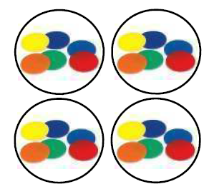
NC Objective: recall and use multiplication facts for the 2, 5 and 10 multiplication tables, including recognising odd and even numbers |  | Small Step: Recognise equal groups
Vocabulary: Groups Lots of Repeated addition Array Times Rows Columns Multiple – Multiply - Multiplication
Representations Children notice arrays in real life and make using object Link to symbolic representation | Children to solve real life problems using arrays and link to bar model |  | Misconceptions Still counts in ones to find how many there are in a collection of equal groups; does not understand vocabulary, for example, ‘groups of’, ‘multiplied by’.
Continue to use groups to find unknown amounts | Children to represent the practical resources in a picture and use a bar model.

Slide 11
NC Objective: recall and use multiplication facts for the 2, 5 and 10 multiplication tables, including recognising odd and even numbers |  | Small Step: Make equal groups
Vocabulary: Groups Lots of Repeated addition Array Times Rows Columns Multiple – Multiply - Multiplication
Representations Children notice arrays in real life and make using object Link to symbolic representation | Children to solve real life problems using arrays and link to bar model |  | Misconceptions Does not link counting up in equal steps to the operation of multiplication; does not use the vocabulary associated with multiplication.
Continue to use groups to find unknown amounts | Children to represent the practical resources in a picture and use a bar model.

Slide 12

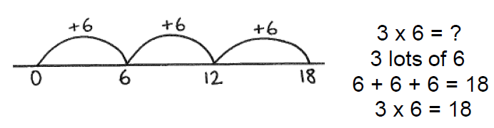
NC Objective: calculate mathematical statements for multiplication within the multiplication tables |  |  | Small Step: Repeated addition
Vocabulary: Groups Lots of Repeated addition Array Times Rows Columns Multiple – Multiply – Multiplication
Representations Continue to use groups to find unknown amounts | Children to solve real life problems using arrays and link to bar model | Children begin to show their understanding on a blank number line |  | Misconceptions Does not link counting up in equal steps to the operation of multiplication; does not use the vocabulary associated with multiplication.
Children notice arrays in real life and make using object Link to symbolic representation |  | Children to represent the practical resources in a picture and use a bar model.

Slide 13
NC Objective: calculate mathematical statements for multiplication within the multiplication tables |  |  | Small Step: Introduce multiplication symbol
Vocabulary: Groups Lots of Repeated addition Array Times Rows Columns Multiple – Multiply – Multiplication
Representations Continue to use groups to find unknown amounts | Children to solve real life problems using arrays and link to bar model | Children begin to show their understanding on a blank number line |  | Misconceptions Does not link counting up in equal steps to the operation of multiplication; does not use the vocabulary associated with multiplication.
Children notice arrays in real life and make using object Link to symbolic representation |  | Children to represent the practical resources in a picture and use a bar model.

Slide 14

NC Objective: show that multiplication of two numbers can be done in any order (commutative) |  |  | Small Step: use different representations to show commutative law.
Vocabulary: Groups Lots of Repeated addition Array Times Rows Columns Multiple – Multiply – Multiplication
Representations Find 4 groups of 3 and 3 groups of 4 – what do they notice? | Children to solve real life problems using arrays and link to bar model | Children begin to show their understanding on a blank number line |  | Misconceptions Children inaccurate when displaying arrays of cubes/objects and so pattern is not clear. Link not clear between the array and the seemingly abstract number given as the answer.
Children notice arrays in real life and make using object Link to symbolic representation |  | Children to represent the practical resources in a picture and use a bar model.

Slide 15
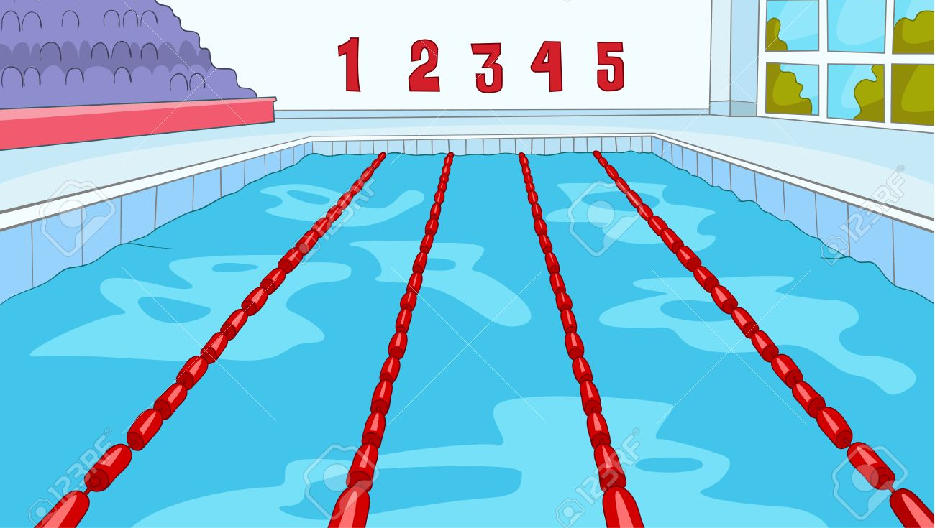







End Goal – Children see a picture like this and can calculate the total number of swimmers by drawing as an array, calculate on a number line, show the commutativity through repeated addition and multiplication question.

Slide 16
Y3

Slide 17
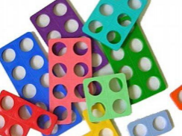
Revisit | NC objectives
Partitioning numbers Number line to subtract 2, 5 and 10 times tables | Pupils should be taught to: recall and use multiplication and division facts for the 3, 4 and 8 multiplication tables write and calculate mathematical statements for multiplication using the multiplication tables that they know, including for two-digit numbers times one-digit numbers, using mental and progressing to formal written methods solve problems, including missing number problems, involving multiplication and division, including positive integer scaling problems and correspondence problems in which n objects are connected to m objects.
Resources
 | Vocabulary Groups Lots of Repeated addition Array Times Rows Columns Multiple – Multiply – Multiplication partition grid method inverse

Slide 18
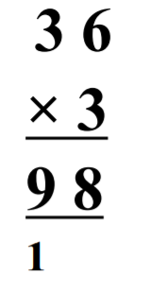
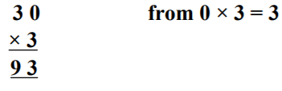
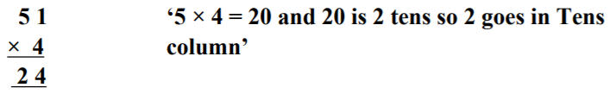
Misconceptions
Forgetting to add on the one that has been exchanged.

Slide 19
When introducing the short written method then considerations needs given to the numbers used in the questions. Choose numbers that require: No exchange in the answer Exchange from O to T in the answer Exchange from T to H in the answer Exchange from O to T and T to H in the answer

Slide 20
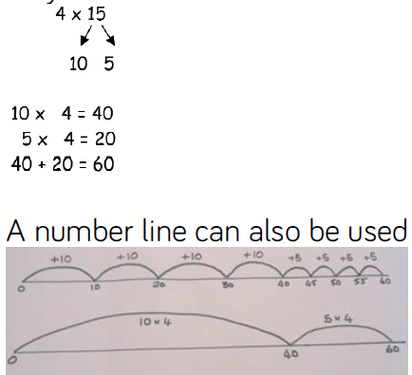
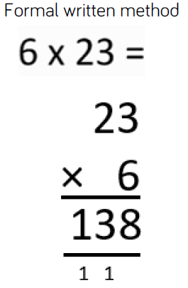
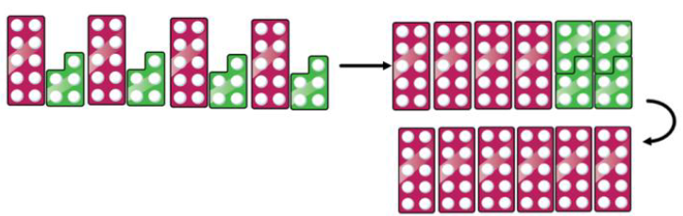
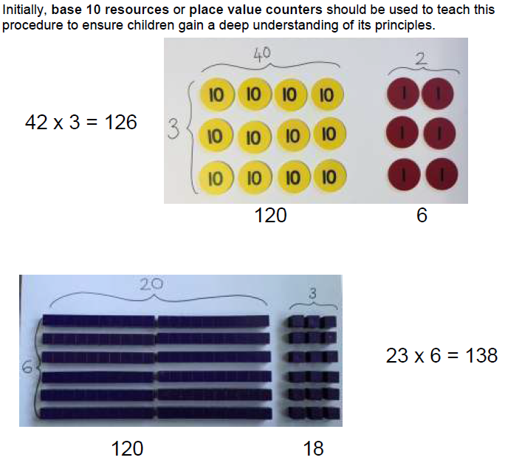
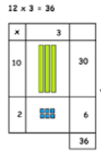
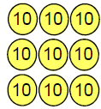

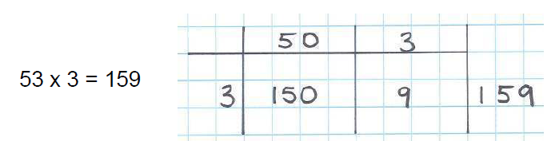
Partition to multiply using Numicon, base 10 or Cuisenaire rods. 4 × 15 | Use base 10 picture to show groups of… | Children show working on blank number line | Children to be encouraged to show the steps they have taken.
23
x 6
120 (20 x 6)
18 ( 3 x 6)
138
Children draw their own PV table and counters/base 10 to represent the number before crossing out as appropriate
Formal column method with place value counters. 32 x 3
As children become more confident, they can move on to recording the same idea using pencil and paper on the grid method.

Slide 21
Y4

Slide 22
Revisit | NC objectives
Partitioning numbers Grid method TO x O Fact Families Expanded notation Multiply by 1, 10 and 100 | Pupils should be taught to: recall multiplication facts for multiplication tables up to 12 × 12 use place value, known and derived facts to multiply mentally, including: multiplying by 0 and 1; dividing by 1; multiplying together three numbers recognise and use factor pairs and commutativity in mental calculations multiply two-digit and three-digit numbers by a one-digit number using formal written layout solve problems involving multiplying and adding, including using the distributive law to multiply two digit numbers by one digit, integer scaling problems and harder correspondence problems such as n objects are connected to m objects.
Resources
 | Vocabulary Groups Lots of Repeated addition Array Times Rows Columns Multiple – Multiply – Multiplication partition grid method inverse

Slide 23
Misconceptions
Pupils do not understand that x10 and then x 10 again, is the same as x100. Prefer to learn ‘add a zero’ and so limited understanding. | Children need to understand the connection between 6 x 3 and 60 x 3, understanding that the answer is 10x bigger because the number being multiplied is 10x bigger.
Children are introduced to formal written methods before fully understand the concept, becomes a test of their memory to remember the ‘rule’, and have no strategies to rely upon when they are ‘stuck’. Problems with place value can cause difficulties with written work. | Children not understand the meaning of ‘lots of’ or ‘groups of’. Children see it as a test of their memory, not linking tables facts.

Slide 24
Proposed teaching sequence
TO x O
HTO x O
When introducing the short written method then considerations needs given to the numbers used in the questions. Choose numbers that require: No exchange in the answer Exchange from O to T in the answer Exchange from T to H in the answer Exchange from H to Th Exchange from two columns

Slide 25
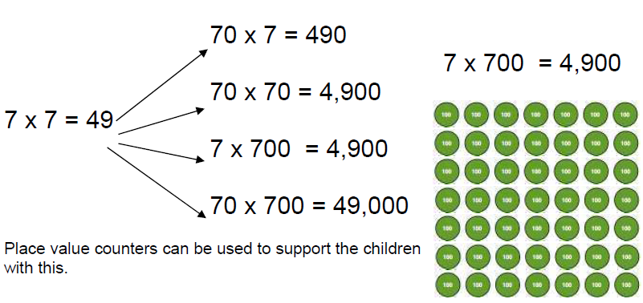
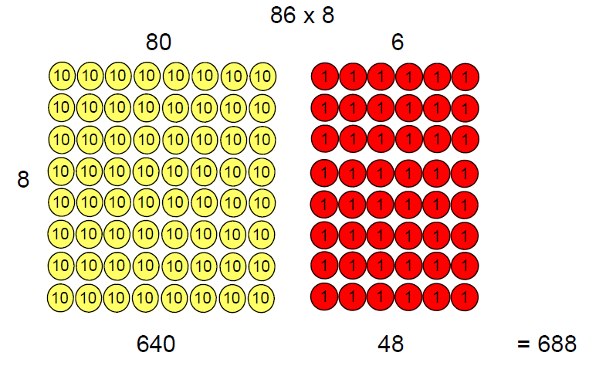
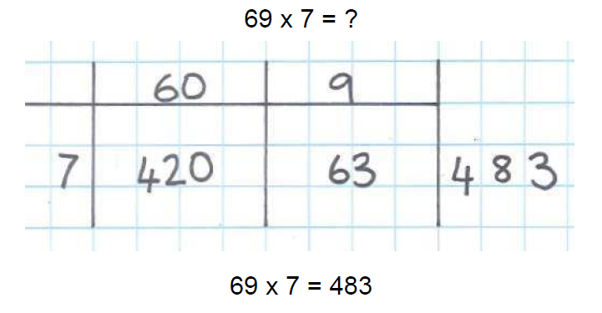
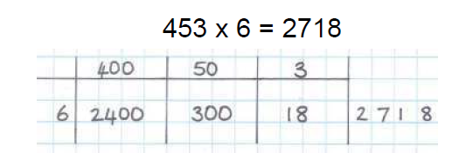
Using known multiplication and division facts, children should be able to derive other associated facts for multiples of 10 and 100.

Slide 26
Y5

Slide 27
Revisit | NC objectives
Children should be able to: Partitioning numbers Times tables up to 12 x 12 Grid method TO x O Fact Families e.g. 5 x 2 = 10 so 5 x 20 = 100 Expanded notation Multiply by 1, 10 and 100 | Pupils should be taught to: recall multiplication facts for multiplication tables up to 12 × 12 use place value, known and derived facts to multiply mentally, including: multiplying by 0 and 1; dividing by 1; multiplying together three numbers recognise and use factor pairs and commutativity in mental calculations multiply two-digit and three-digit numbers by a one-digit number using formal written layout solve problems involving multiplying and adding, including using the distributive law to multiply two digit numbers by one digit, integer scaling problems and harder correspondence problems such as n objects are connected to m objects.
 | Vocabulary Groups Lots of Repeated addition Array Times Rows Columns Multiple – Multiply – Multiplication cube numbers, prime numbers, square numbers, common factors, prime factors, composite numbers, common factors, short division, inverse, power of.
Resources

Slide 28
Misconceptions
Pupils do not understand that x10 and then x 10 again, is the same as x100. Prefer to learn ‘add a zero’ and so limited understanding. | Children need to understand the connection between 6 x 3 and 60 x 3, understanding that the answer is 10x bigger because the number being multiplied is 10x bigger.
Children are introduced to formal written methods before fully understand the concept, becomes a test of their memory to remember the ‘rule’, and have no strategies to rely upon when they are ‘stuck’. Problems with place value can cause difficulties with written work. | Children not understand the meaning of ‘lots of’ or ‘groups of’. Children see it as a test of their memory, not linking tables facts.

Slide 29
Proposed teaching sequence
Multiply numbers mentally drawing upon known facts e.g. 7 x 6 = 42 so 7 x 60 = 420 and 7 x 0.6 = 4.2
HTO x O
ThHTO x O
TO x TO
HTO x TO
ThHTO x TO
When introducing the short written method then considerations needs given to the numbers used in the questions. Choose numbers that require: No exchange in the answer Exchange from one column Exchange from two columns

Slide 30
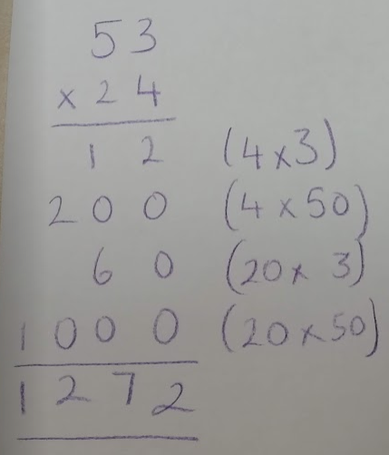
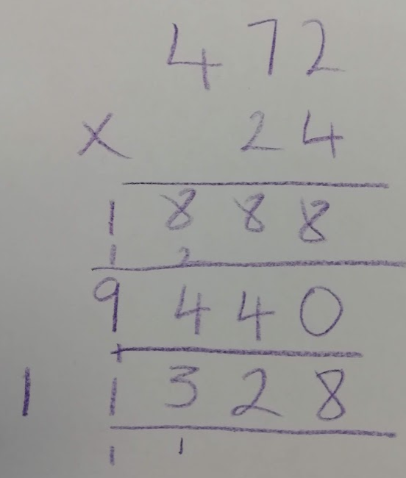
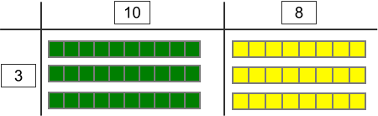
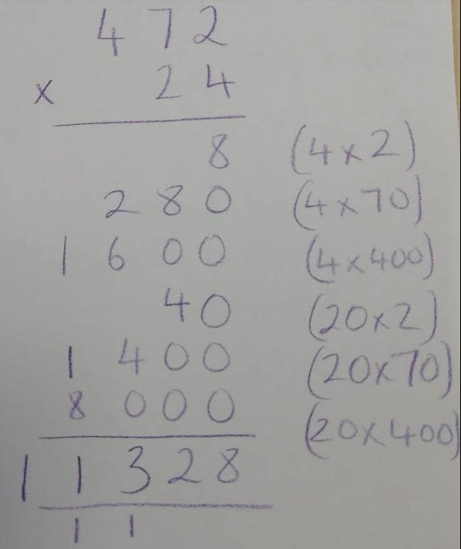
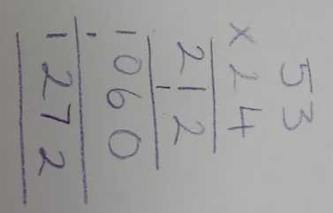

Slide 31
Y6

Slide 32
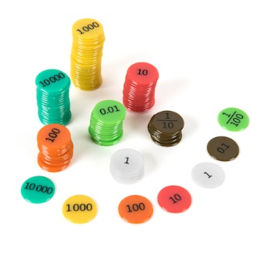
Revisit | NC objectives
Children should be able to: Partitioning numbers – including decimals Times tables up to 12 x 12 Grid method ThHTO x O Fact Families e.g. 5 x 2 = 10 so 0.5 x 20 = 10 Expanded notation Multiply by 1, 10 and 100 Short multiplication | Pupils should be taught to: multiply multi-digit numbers up to 4 digits by a two-digit whole number using the formal written method of long multiplication identify common factors, common multiples and prime numbers use their knowledge of the order of operations to carry out calculations involving the four operations multiply one-digit numbers with up to two decimal places by whole numbers
 | Vocabulary Groups Lots of Repeated addition Array Times Rows Columns Multiple – Multiply – Multiplication cube numbers, prime numbers, square numbers, common factors, prime factors, composite numbers, common factors, short division, inverse, power of.
Resources

Slide 33
Misconceptions
Misunderstand the concept of making a number 10/100/1000 times bigger, prefer to learn ‘add a zero’. Causes difficulties when working with decimal numbers and fractions. Children introduced to formal written strategy too early, when ‘stuck’ reach for a calculator because have no strategy of their own. | Ignore decimal point, perform calculation, then ‘count how many digits after the point’. Effective shortcut, but difficulty when applying to mental work – encourage ‘why does it work?’
Children are taught to multiply single digits and count the number of zeros. 20 x 50 = 100 is a common mistake as children don’t know what to do with the ‘extra’ zero | Place value errors when performing written calculations can cause problems for even able pupils.

Slide 34
Proposed teaching sequence
TO x TO
HTO x TO
ThHTO x TO
O.t x O
O.t x TO
When introducing the short written method then considerations needs given to the numbers used in the questions. Choose numbers that require: No exchange in the answer Exchange from one column Exchange from two columns

Slide 35



 | 2 | 1 | 3
3

