Slide 1


Calculation guidance for written methods of division

Slide 2
Y1

Slide 3
Proposed teaching sequence
Understand division as sharing
Understand division as grouping

Slide 4
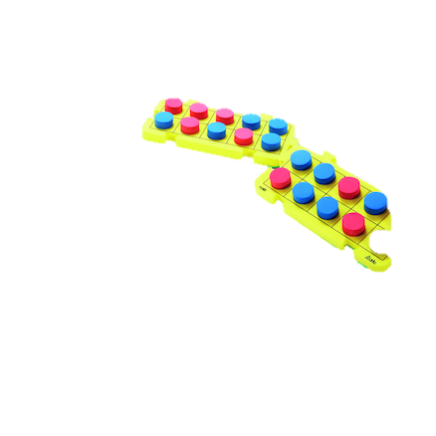
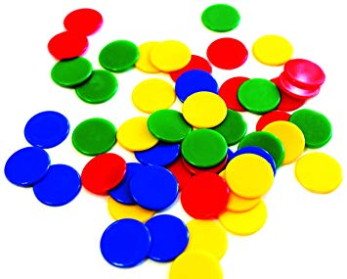
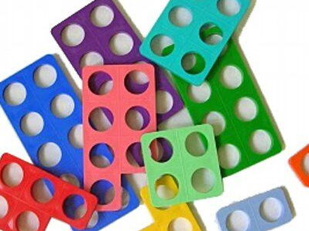

Revisit | NC objectives
 | recall and use division facts for the 2, 5 and 10 multiplication tables, including recognising odd and even numbers calculate mathematical statements for division within the multiplication tables and write them using division (÷) and equals (=) signs show that multiplication of two numbers can be done in any order (commutative) and division of one number by another cannot solve problems involving division, using materials, arrays, repeated addition, mental methods, and multiplication and division facts, including problems in contexts.
Resources

Slide 5
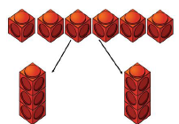
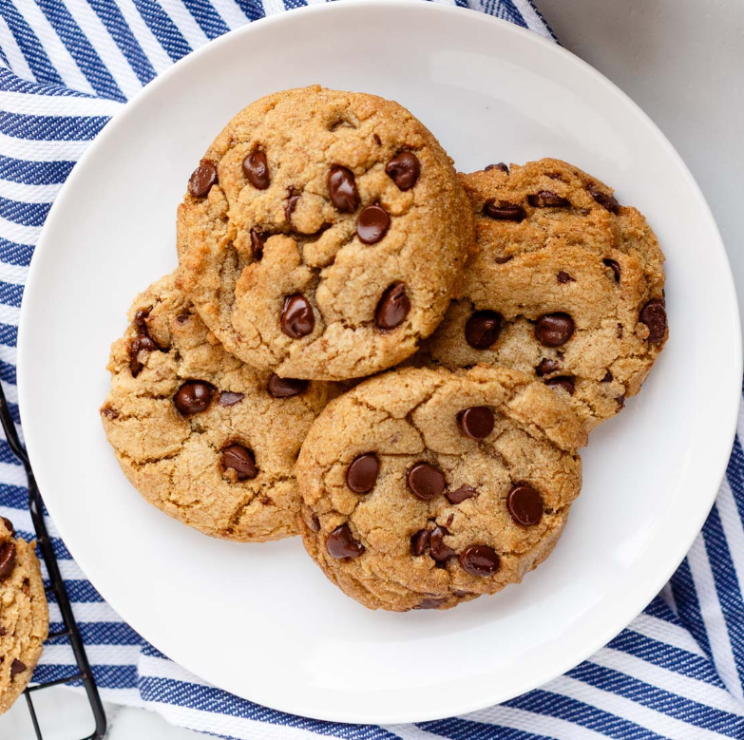

NC Objective: solve one-step problems involving division, by calculating the answer using concrete objects, pictorial representations and arrays with the support of the teacher. |  |  | Small Step: Understand division as sharing
Vocabulary: lots of, groups of´, times, repeated subtraction array row, column, halve share, share equally one each, two each, three each… group in pairs, threes… tens equal groups of, divide, divided by, divided into
Representations Share physical objects between different number of groups | Use cubes/counters to represent other object e.g. cookies | Misconceptions
 |  | Is not systematic when sharing into equal groups, using a ‘one for you’ approach; does not use the language of division to describe the process. |  | Is not systematic when sharing into equal groups, using a ‘one for you’ approach; does not use the language of division to describe the process.
Draw pictures to represent physical objects | Bar model | End Goal Children understand the concept of division as sharing and can take physical objects and share them equally between different numbers of groups. They can draw this pictorially and understand when something has not been shared equally.
6 ÷ 2 = 3

Slide 6
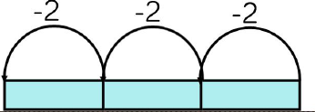



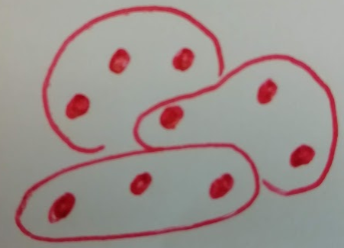
NC Objective: solve one-step problems involving division, by calculating the answer using concrete objects, pictorial representations and arrays with the support of the teacher. |  |  | Small Step: Understand division as grouping
Vocabulary: lots of, groups of´, times, repeated subtraction array row, column, halve share, share equally one each, two each, three each… group in pairs, threes… tens equal groups of, divide, divided by, divided into
Representations Cuisenaire rods used in conjunction with number line | Numicon used in conjunction with number line | Misconceptions
Children organise themselves in to groups of varying numbers | Picture of objects and children put in to groups of varying numbers. Alternatively, children draw 3 objects at a time a group together with a circle. | End Goal

Slide 7
Y2

Slide 8
Revisit | NC objectives
 | calculate mathematical statements for division within the multiplication tables and write them using the division (÷) and equals (=) signs
Resources

Slide 9
Proposed teaching sequence

Slide 10
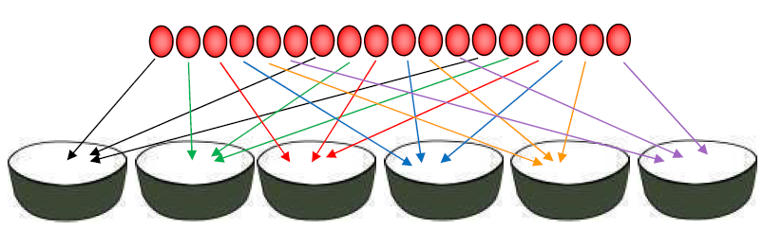
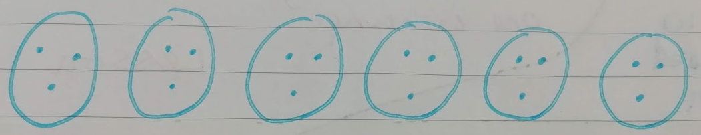
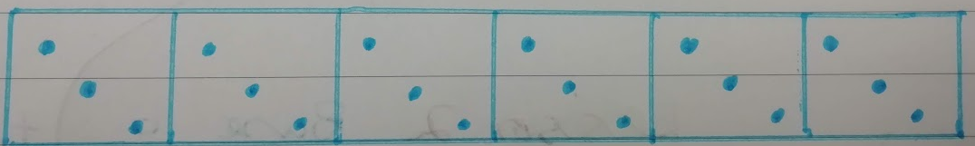
NC Objective: solve one-step problems involving division, by calculating the answer using concrete objects, pictorial representations and arrays with the support of the teacher. |  |  | Small Step: Understand division as sharing – Use same representations as in Y1 but use multiplication and division facts from Y2
Vocabulary:
Representations Share physical objects between different number of groups 18 ÷ 6 = 3 |  | Misconceptions
Draw pictures to represent physical objects | Bar model
 |  | End Goal
18 ÷ 6 = 3

Slide 11
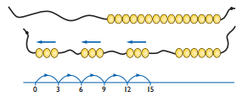
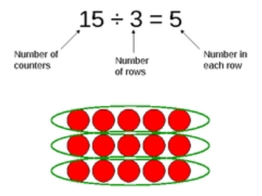
NC Objective: |  |  | Small Step: Understand division as grouping
Vocabulary: multiple, multiplication array, multiplication tables/facts, groups of, lots of, times, columns, rows, group in pairs, 3s 5s 10s, equal groups of, divide, ÷, divided by, divided into, shared into, remainder.
Representations Use Cuisenaire rods to show division as group which will then link to use of bar model |  | Misconceptions
Children represent Cuisenaire rods as bar model and move to bar model alone when secure in times table facts |  | End Goal
24
6 | 6 | 6 | 6
Group from zero in jumps of the divisor to find our ‘how many groups of 3 are there in 15?’.
15 ÷ 3 = 5

Slide 12
Y5

Slide 13
Revisit | NC objectives
 | recall and use multiplication and division facts for the 3, 4 and 8 multiplication tables write and calculate mathematical statements for division using the multiplication tables that they know, including for two-digit numbers divided by one-digit numbers, using mental and progressing to formal written methods solve problems, including missing number problems, involving multiplication and division, including positive integer scaling problems and correspondence problems in which n objects are connected to m objects.
Resources

Slide 14
Proposed teaching sequence
Dividing a 4-digit number by a 1-digit no remainder
Dividing a 4-digit number by a 1-digit remainder in one column
Dividing a 4-digit number by a 1-digit remainder in two columns
Dividing a 4-digit number by a 1-digit remainder in final column in order to interpret in context

Slide 15
NC Objective: divide numbers up to 4 digits by a one-digit number using the formal written method of short division and interpret remainders appropriately for the context |  |  | Small Step: Divide 4 digit by 1 digit with no remainders in any column e.g. 3669 ÷ 3
Vocabulary:
Representations x1000 x200 x20 x3 0 3000 3600 3660 3669 | 1223 | Misconceptions
 |  | End Goal
Both physically manipulate and draw place value tables
3 3669
Th | H | The | O

Slide 16
NC Objective: divide numbers up to 4 digits by a one-digit number using the formal written method of short division and interpret remainders appropriately for the context |  |  | Small Step: Divide 4 digit by 1 digit with remainders in one column e.g. 4269 ÷ 3
Vocabulary:
Representations x1000 x400 x20 x3 0 3000 4200 4260 4269 | 1423 | Misconceptions
 |  | End Goal
Both physically manipulate and draw place value tables
3 4¹269
Th | H | The | O

Slide 17
NC Objective: divide numbers up to 4 digits by a one-digit number using the formal written method of short division and interpret remainders appropriately for the context |  |  | Small Step: Divide 4 digit by 1 digit with remainders in two columns e.g. 4269 ÷ 3
Vocabulary:
Representations x1000 x400 x20 x6 0 3000 4200 4260 4278 | 1426 | Misconceptions
 |  | End Goal
Both physically manipulate and draw place value tables
3 4¹27¹8
Th | H | The | O

Slide 18
NC Objective: divide numbers up to 4 digits by a one-digit number using the formal written method of short division and interpret remainders appropriately for the context |  |  | Small Step: Divide 4 digit by 1 digit with remainders in final column and interpret remainder
Vocabulary:
Representations x1000 x300 x20 x2 0 3000 3900 3960 3966 | 1322r2 | Misconceptions
 |  | End Goal
Both physically manipulate and draw place value tables
3 3968
Th | H | The | O

Slide 19
Y6

Slide 20
Revisit | NC objectives
 | recall and use multiplication and division facts for the 3, 4 and 8 multiplication tables write and calculate mathematical statements for division using the multiplication tables that they know, including for two-digit numbers divided by one-digit numbers, using mental and progressing to formal written methods solve problems, including missing number problems, involving multiplication and division, including positive integer scaling problems and correspondence problems in which n objects are connected to m objects.
Resources

Slide 21
Proposed teaching sequence
Dividing a 4-digit number by a 2-digit no remainder
Dividing a 4-digit number by a 2-digit remainder in one column
Dividing a 4-digit number by a 2-digit remainder in two columns
Dividing a 4-digit number by a 2-digit remainder in final column in order to interpret in context

Slide 22
NC Objective: divide numbers up to 4 digits by a one-digit number using the formal written method of short division and interpret remainders appropriately for the context |  |  | Small Step: Divide 4 digit by 1 digit with no remainders in any column e.g. 3669 ÷ 3
Vocabulary:
Representations x1000 x200 x20 x3 0 3000 3600 3660 3669 | 1223 | Misconceptions
 |  | End Goal
Both physically manipulate and draw place value tables
3 3669
Th | H | The | O

