Slide 1
Science
South Wilford C of E Primary School
Subject Lead: Alicea Gibson
Curriculum leaders: Joseph, Nataniel & SuJung

Slide 2
Intent
Our aim at South Wilford is to provide a rich and exciting curriculum in Science, which challenges, inspires and motivates all children to know more and want to discover more about the ever-evolving world in which they live.
From making them aware of their responsibilities to protect the environment and creatures in it, to growing their sense of curiosity for latest scientific discoveries, we will encourage each child to develop their own lines of enquiry with which to investigate through practical experiments and independent discovery. Hence, they will acquire critical thinking skills to enhance their scientific knowledge and deepen their understanding of our global curriculum. Wider opportunities including visits, visitors and STEM experiences will create awe and wonder, igniting their enthusiasm and belief that they can become the scientists of tomorrow.

Slide 3
Implementation
Four or five topics of Science will be taught across each phase (KS1, LKS2, UKS2) throughout the year on a weekly basis.
NC, ASE, Explorify and Gramasaurus Skills and Knowledge Progression in Science documents are used to plan, teach and assess pupils.
A consistent sequence of learning will be planned and delivered with investigations forming the basis of lessons.
Cross-curricular links (Computing, Art and Design, D & T, Mathematics).
Corridor/hall displays (raise profile/awareness of Science)
Curriculum information updated on website (NC Science scheme of work, curriculum maps)
Pupil voice surveys to evaluate, inform and develop teaching and learning in Science.
Science trackers for each year will identify those children working below, at or exceeding expectations so support/extensions can be planned for and levels logged on Insight.

Slide 4
Learning
In EYFS Science is part of ‘Understanding the World’ and is taught as part of the half termly topics/cross-curricular. It is practical based (investigation station) and pupil led (continuous provision both indoors and outdoors). KS1 and KS2 follow the National Curriculum using a framework of progression in both skills and knowledge mapped out to ensure complete coverage and sequencing. Also, distinct Working Scientifically objectives ongoing throughout the year. All strands of Science (Biology, Chemistry and Physics) are covered in KS1, LKS2 and UKS2 and linked to the topic/cross curricular wherever possible:
• Y1 – Biology (Plants, Animals including Humans), Chemistry (Everyday Materials), Physics (Seasonal Changes)
• Y2 - Biology (Plants, Animals including Humans, Living Things and their Habitats), Chemistry (Uses of Everyday Materials)
• Y3 – Biology (Plants, Animals including Humans), Chemistry (Rocks), Physics (Forces and Magnets, Light)
• Y4 – Biology (Animals including Humans, Living Things and their Habitats), Chemistry (States of Matter), Physics (Sound)
• Y5 - Biology (Animals including Humans, Living Things and their Habitats), Chemistry (Properties and Changes of Materials), Physics (Forces)
• Y6 - Biology (Animals including Humans, Living Things and their Habitats, Evolution and Inheritance), Physics (Electricity and Light)

Slide 5
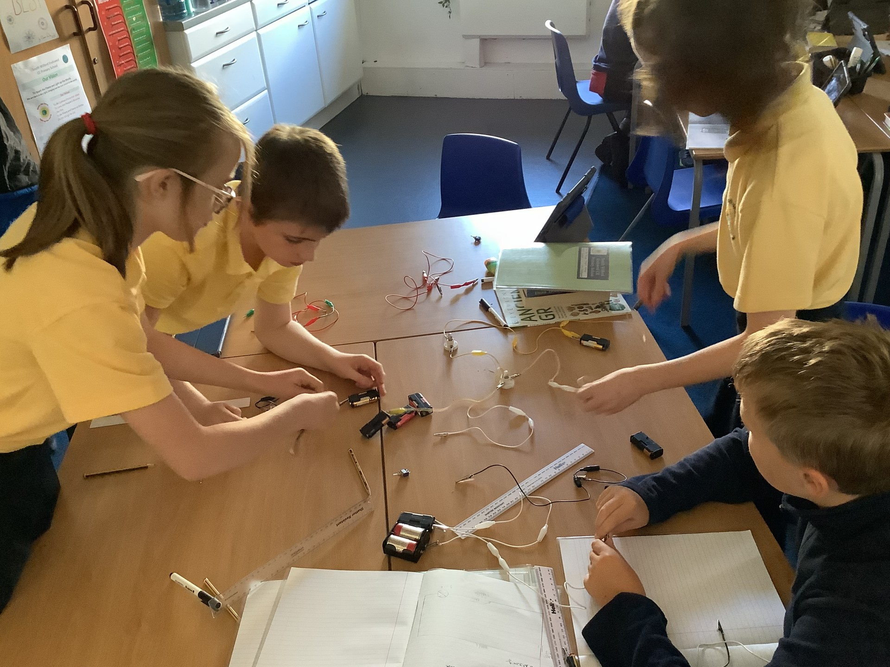
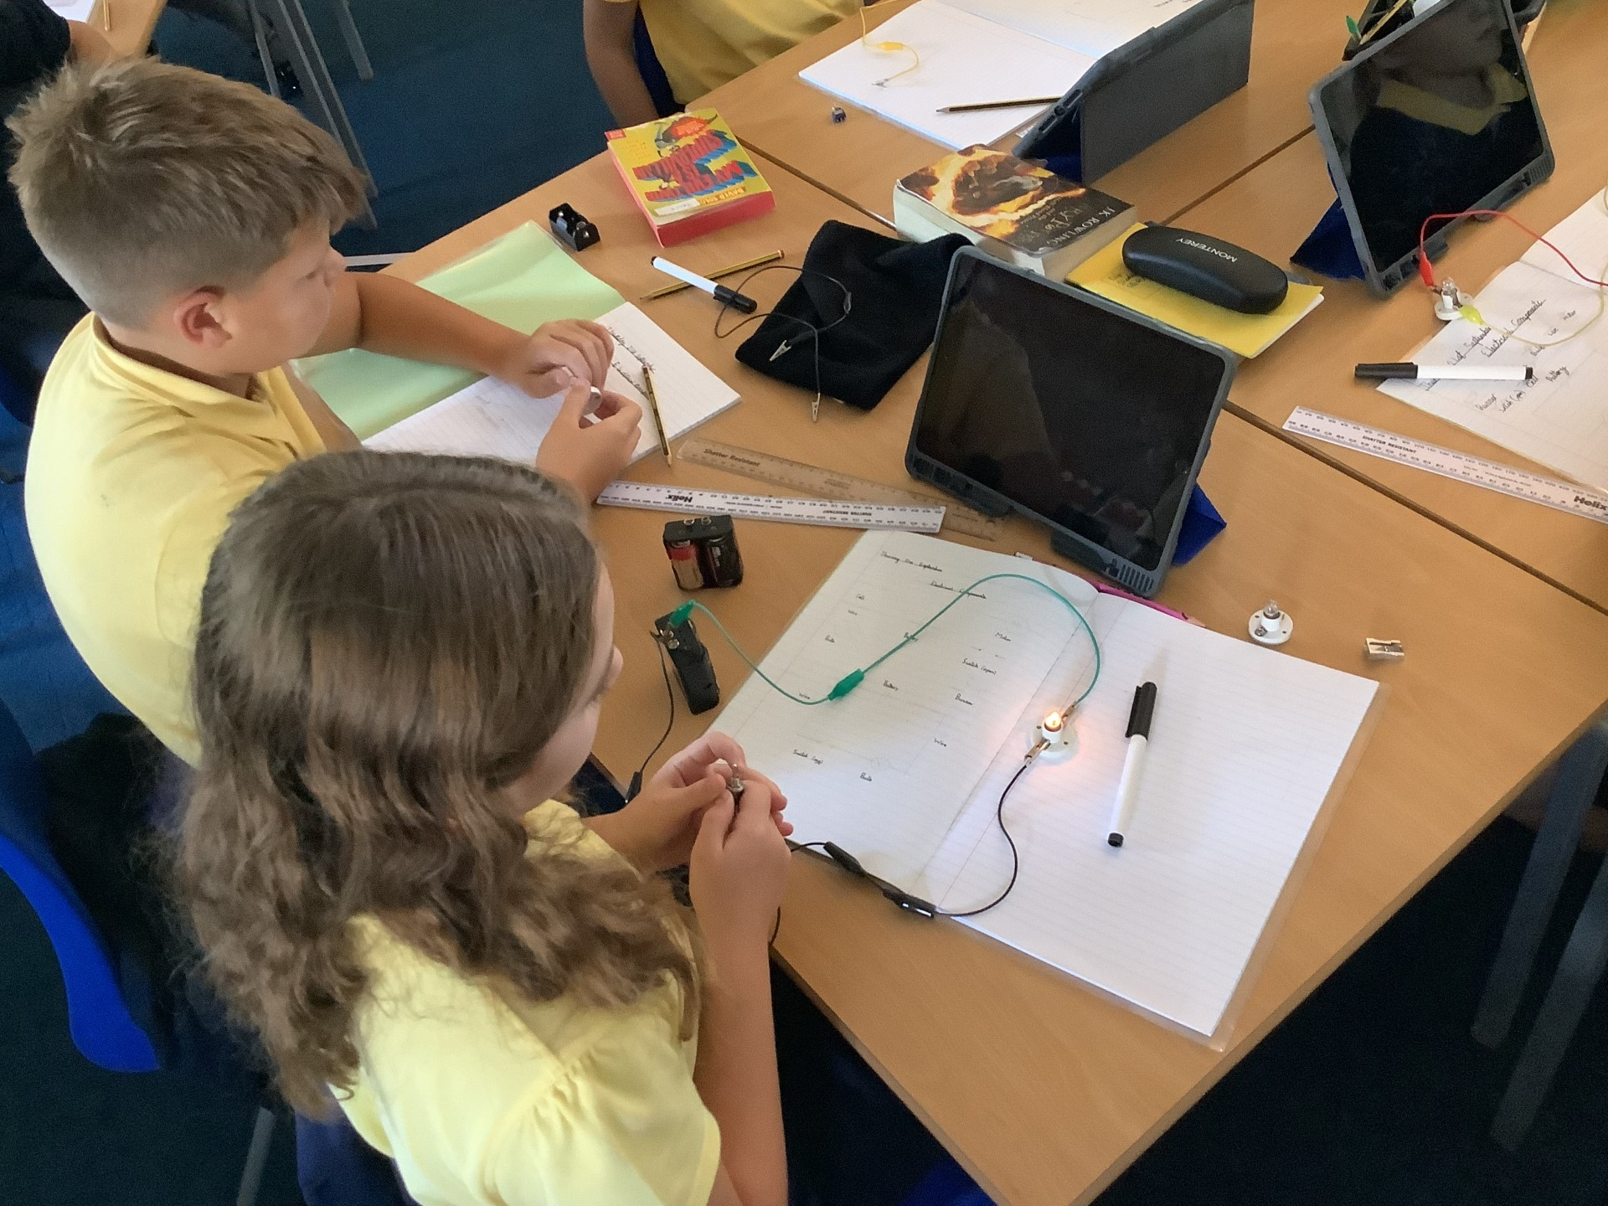
Investigations
Investigations and practical experiments are at the core of our Science curriculum.
Children are given the opportunity to investigate independently.
We record investigations in books, on iPads or as whole class discussions.

Slide 6
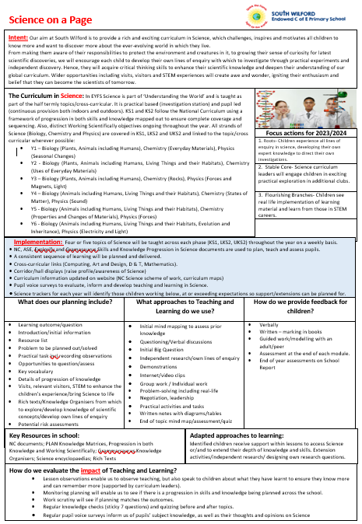
Subject on a page

Slide 7
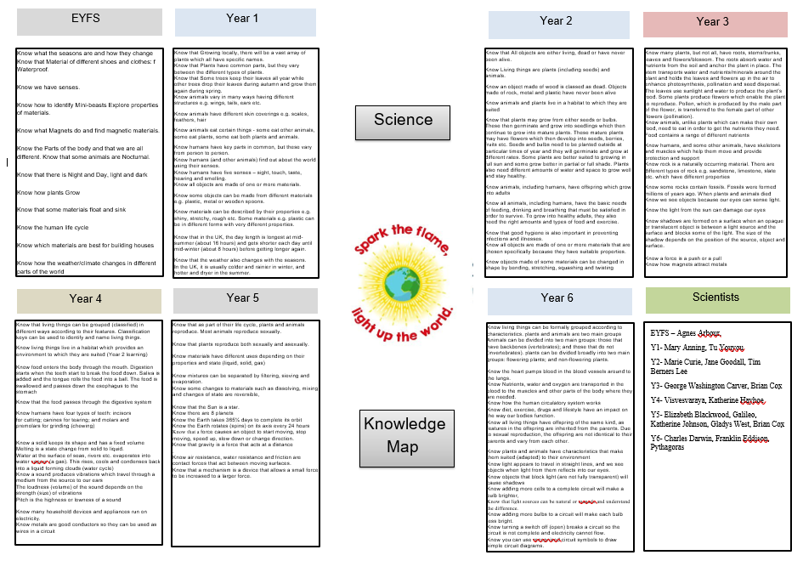

Slide 8
Exceptionality Flourishing!
Real life Context - Establish community links.
Science Assemblies to create awe and wonder.
Visits/ Visitors that expand children’s knowledge of topic/real life application.
Sharing of scientific investigation with local community.
Establish whether any of the wider community can support with adding any knowledge or expertise to any topic being taught.
Show positive role models.
Visits happening across the year group.
Celebration and parents invited in to share work after Science week.
Use of digital opportunities to enhance learning.

Slide 9
Pupil Voice
“ I personally like the experiments and think they are really cool, I like to see what happens” – Ben Y6
“I enjoy Science, mainly doing the experiments but also drawing diagrams to show what I have learned” – Sienna Y6

Slide 10
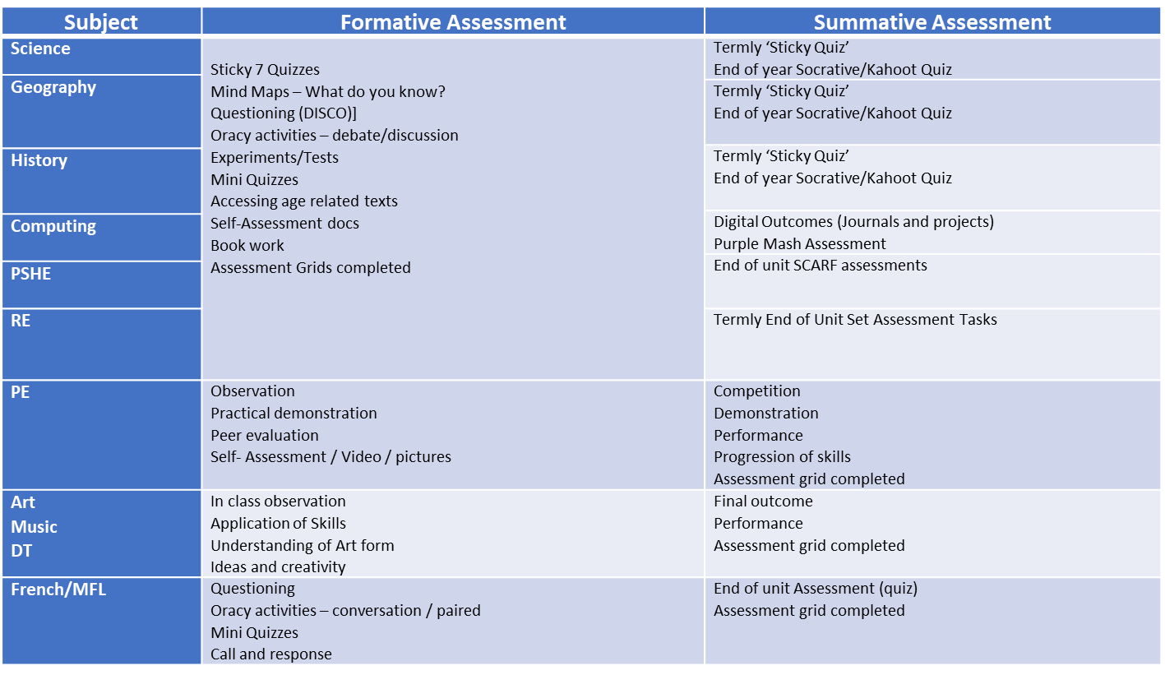
Assessment

Slide 11
Supporting everyone
Challenging: high expectations for all children (DISCO) challenging curriculum
Diversity: representation for all within the curriculum through range of musicians, instruments and genres
Inclusive: ensuring all children can access the curriculum
Accessible: opportunities for all children
Enrichment: music, sport, drama, trips, visitors, experiences
Support/Stretch: TA, scaffolding, Quality First teaching, Arc
Wellbeing: Brighter Futures, ELSA

